Slide 1
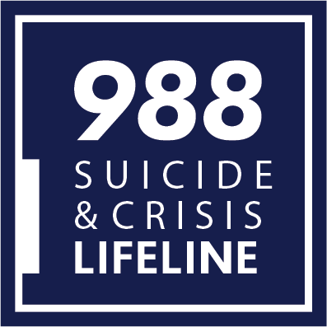
988 Suicide & Crisis Lifeline
Laura Evans
Director, National and State Policy
Shye Louis, M.Ed.
AVP - Clinical Standards, Training & Practices

Slide 2
Disclaimer
The views, opinions, and content expressed in this presentation do not necessarily reflect the views, opinions, or policies of the Center for Mental Health Services, the Substance Abuse and Mental Health Services Administration (SAMHSA), or the U.S. Department of Health and Human Services.

Slide 3
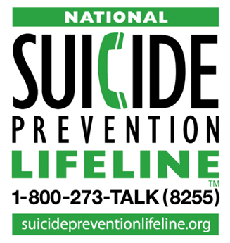
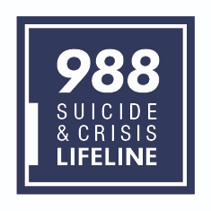
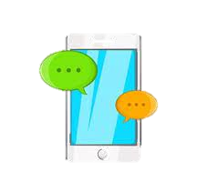
What is the 988 Suicide and Crisis Lifeline?
National Suicide Prevention and Mental Health Crisis hotline system available by calling or texting 988. Chat services are also available at 988Lifeline.org

Slide 4
How does 988 Build and Expand on the Lifeline?
Scale of access and visibility: 3-digit number intended to penetrate public awareness
Scope of service: suicide and mental health crises; emphasis on crisis care continuum
Equity of access: essential that service is equally accessible to all persons in suicidal/mental health crisis (must reach and serve persons with functional, linguistic and access needs)
Access to omni-channel services: expansion to assure accessibility to call, chat, text and follow-up capabilities
Access to specialized services: to serve LGBTQ+ youth, AI/AN people, communities of color, rural individuals and other high-risk populations
Stakeholder investment in service: greater public funding (e.g, Federal and State) and public visibility will impact service expectations/standards for network performance

Slide 5
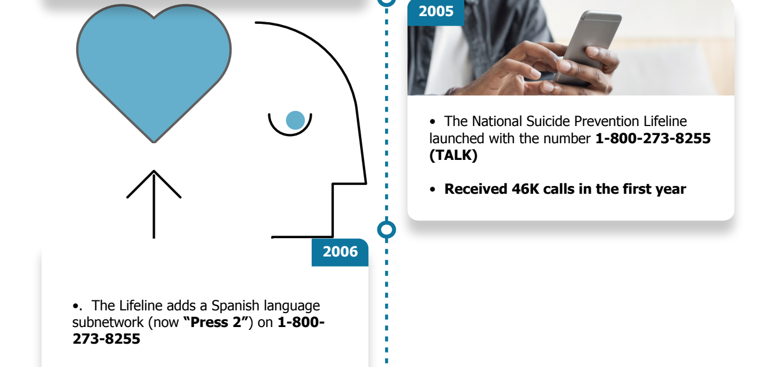
Brief Lifeline History

Slide 6
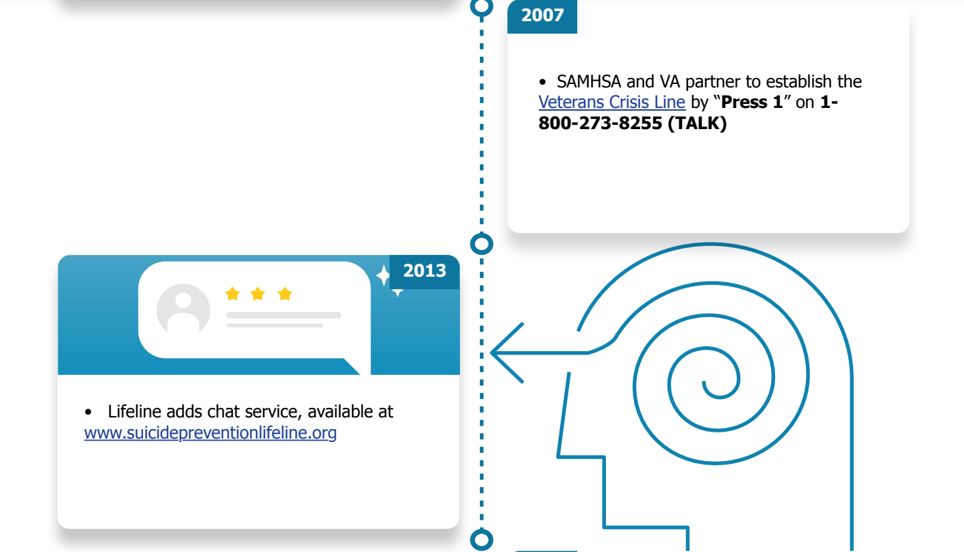
Brief Lifeline History

Slide 7
Brief Lifeline History

Slide 8
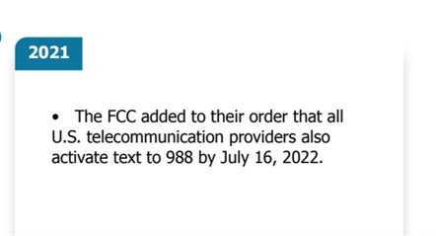
Brief Lifeline History

Slide 9
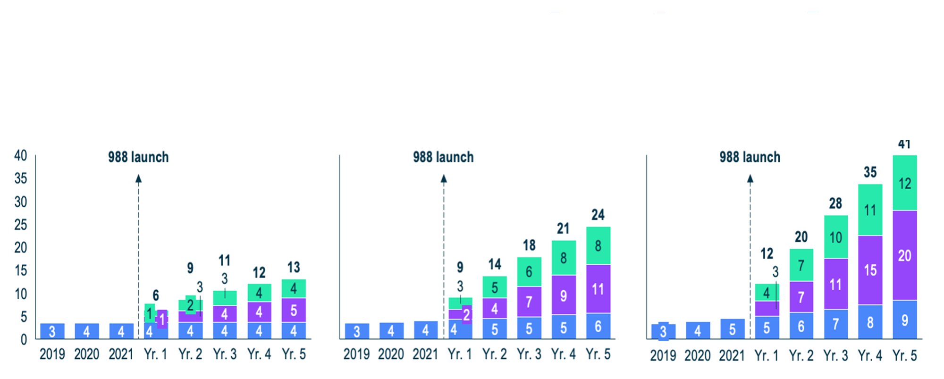
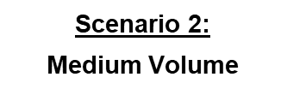
988 Lifeline Volume Estimates

Slide 10
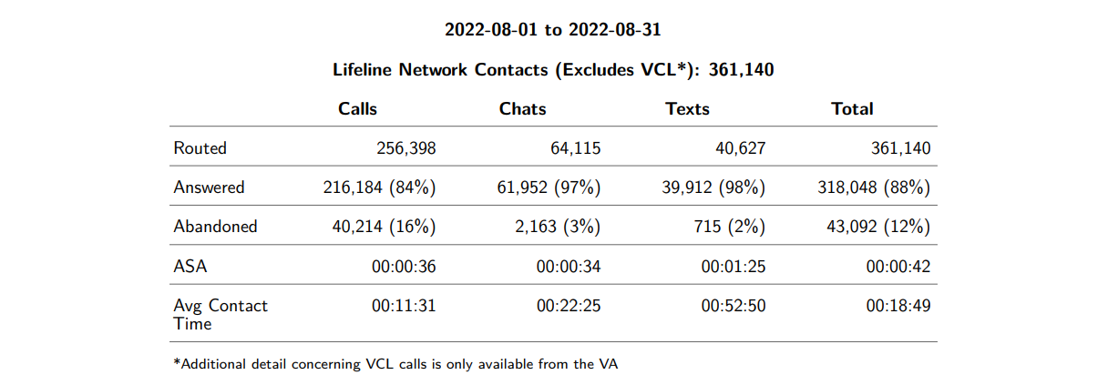
August 2022 988 Lifeline Data

Slide 11
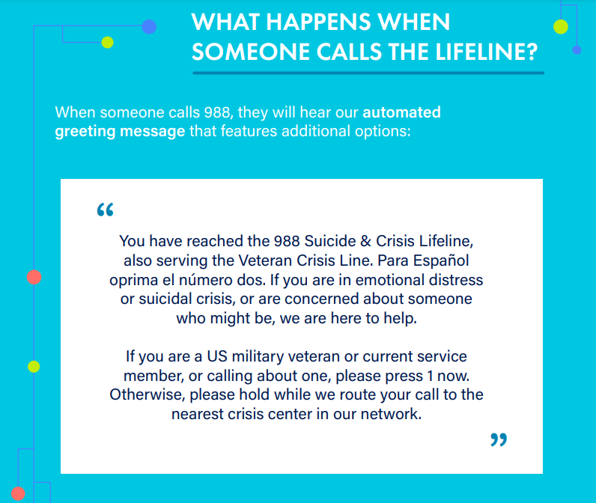

Slide 12
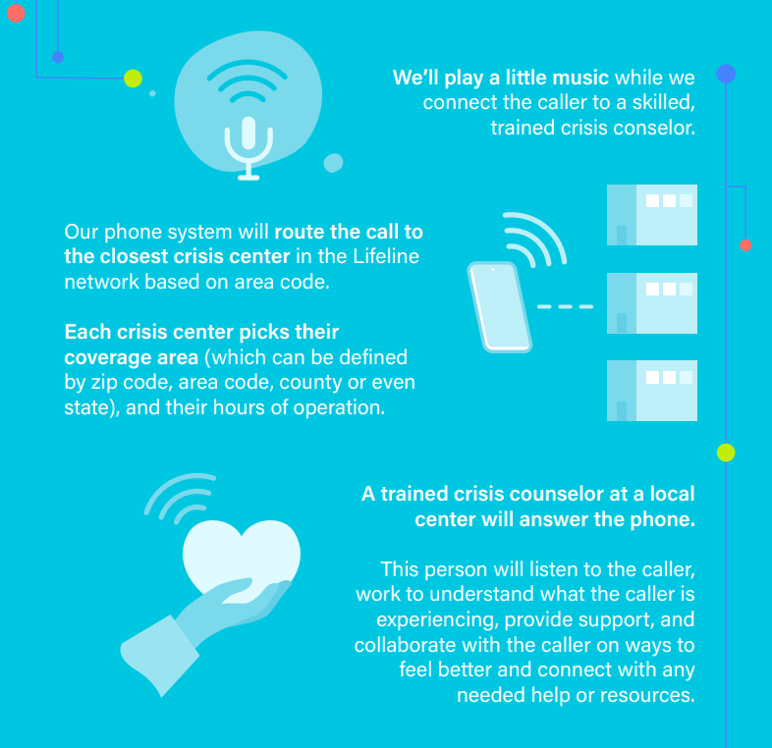

Slide 13
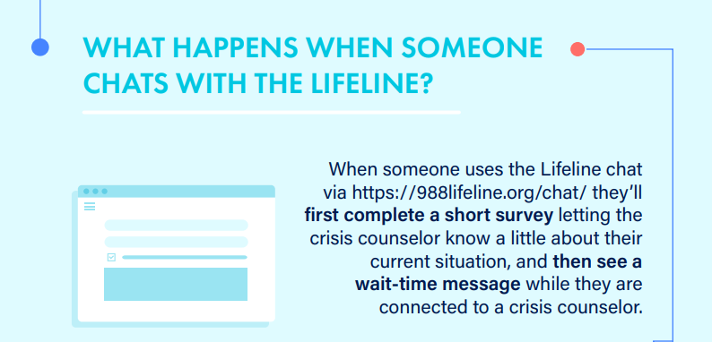

Slide 15
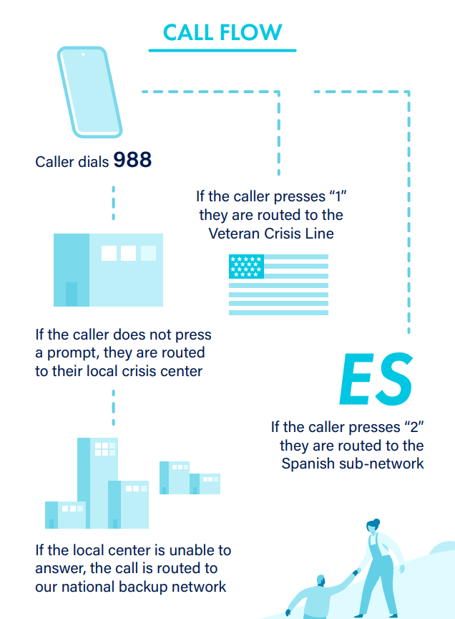

Slide 16
Lifeline Continuous QI
Standards, Trainings & Practices Committee
Lived Experience Committee
Steering Committee
988 Lifeline Standards and Policies
COMMITTEES: IDENTIFY BEST PRACTICES
STANDARDS, GUIDELINES & POLICIES
IMPLEMENT
TRAINING & T.A.
EVALUATION
… Evaluations to Best Practice
Notes:
[dk] conform style

Slide 17
Lifeline Crisis Services & Best Practices Effectively Reduce Distress and Suicidality
Callers’ emotional distress and suicide risk (e.g., intent to die) is significantly reduced from the beginning to the end of the call. (Gould et al., 2007)
RAND Study: Callers to Lifeline crisis centers are more likely to be assessed for suicide and report less distress by end of the call than non-Lifeline centers (Ramchand, 2014)
Crisis counselors are able to secure the caller’s collaboration on intervention on over 75% of imminent risk calls. (Gould et al., 2016)
Two-thirds of chatters reported that chat was helpful and that they were significantly and substantially less distressed at the end of the chat intervention than they were at the beginning. Moreover, about half reported being less suicidal at the end of the chat. (Gould et al., 2021)
Lifeline follow-up calls to persons at risk: 80% say calls helped keep them safe, with half saying “it’s the reason I’m alive” (Gould et al, 2018)

Slide 18
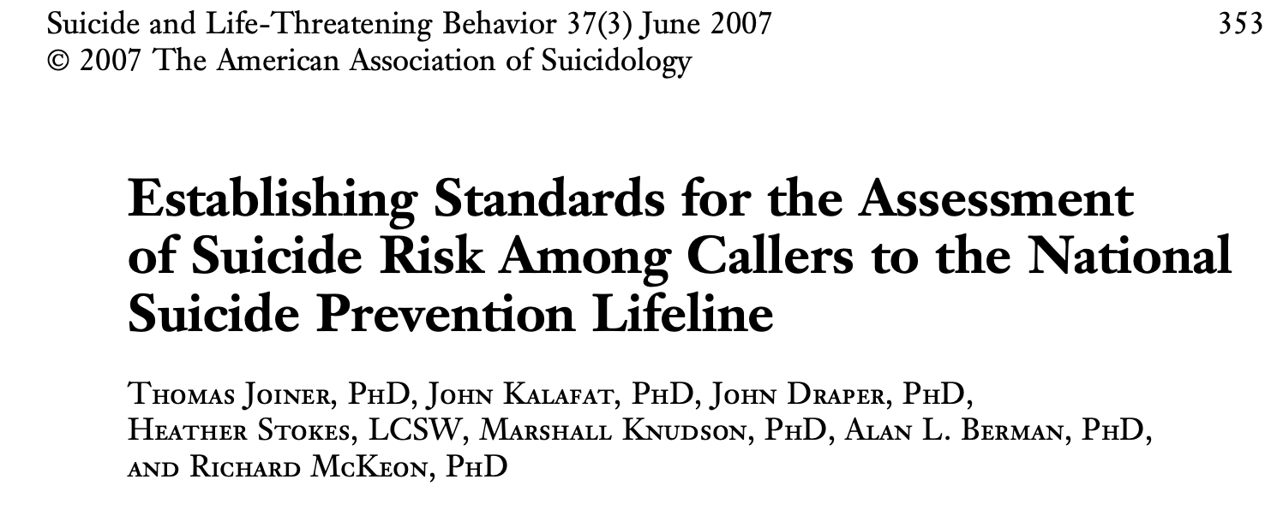
988 Lifeline Standards and Policies
Suicide Risk Assessment Standards (2007)

Slide 19
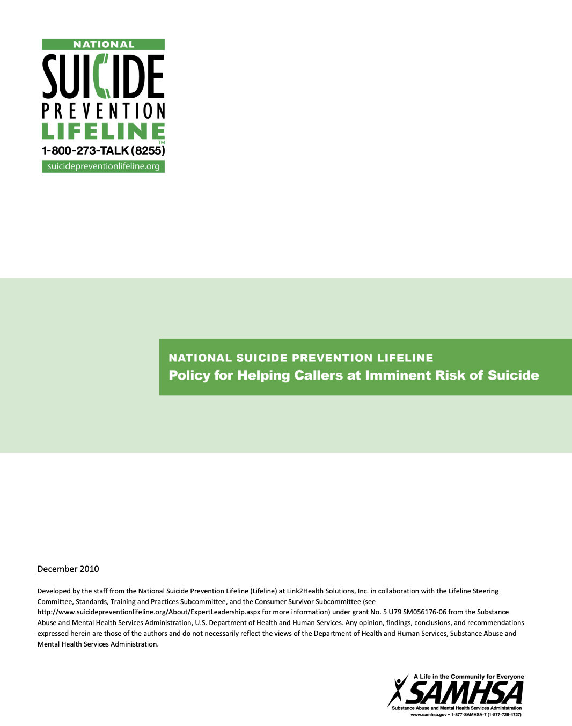
988 Lifeline Standards and Policies
Imminent Risk Policy Requirements (2011)
Safety First: “Whereas the primary mission of the Lifeline is to prevent the suicide of callers to its service, all crisis center staff must undertake necessary actions intended to secure the safety of callers determined to be attempting suicide or at imminent risk of suicide.”
Collaboration Critical to Best Assure Safety:
With people contacting service
With local crisis and emergency services (MCTs, 911, etc.)

Slide 20
988 Lifeline Standards and Policies
Imminent Risk Policy Requirements (2011)
Principles of Counselor Imminent Risk Response:
Active Engagement (collaboration for safety)
Least Invasive Intervention (alternatives to 911)
Emergency Intervention (engage 911 as last resort)

Slide 21
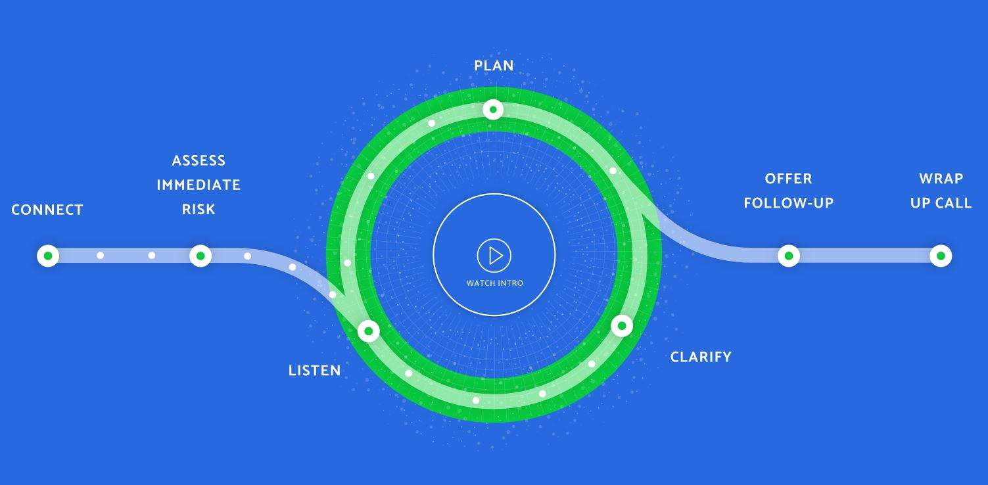
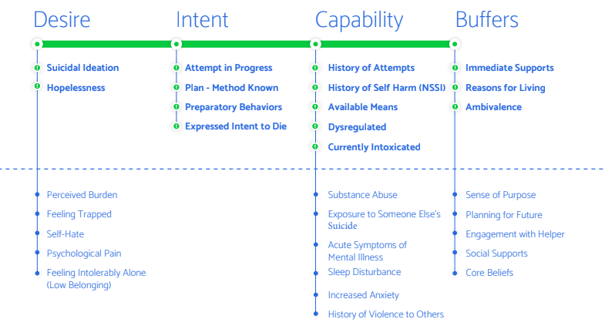
988 Lifeline Standards and Policies
Safety Assessment Model (2019)

Slide 22
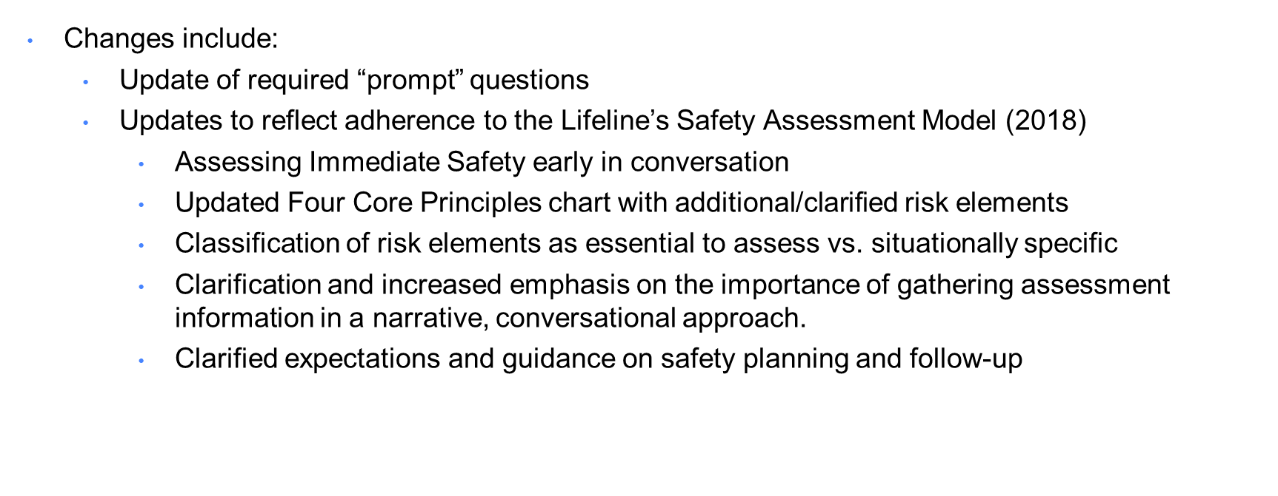
988 Lifeline Standards and Policies
Suicide Safety Policy (coming Fall 2022)
Combines and replaces the Lifeline Risk Assessment Standards and the Policy (2007) for Helping Callers at Imminent Risk (2011)

Slide 23
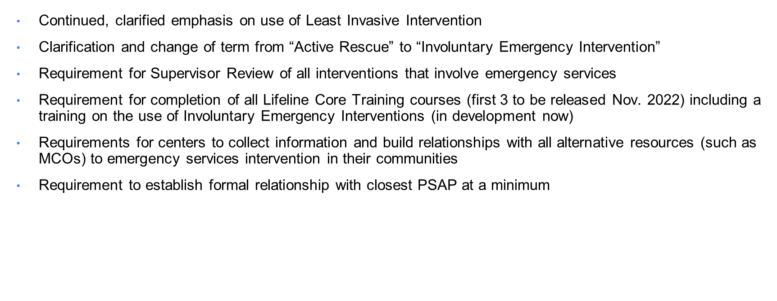
988 Lifeline Standards and Policies
Suicide Safety Policy (coming Fall 2022)
Changes/updates (continued)

Slide 24
988 Lifeline Crisis Counselor Training
Current:
Centers develop training curriculum
Meet Lifeline standards
Accrediting body standards
Lifeline provides support
Guidance docs, tip sheets, webinars
Safety Assessment site, simulated conversations, videos
Future:
Development of LMS – launching Nov 2022
Core clinical courses
Additional courses and supports
Notes:
A crisis center is a facility, often with an embedded call center, where people going through personal crises can obtain compassionate, non-judgemental emotional support, crisis assessment and intervention if needed, and linkage with resources, either in person, telephonically, via text or chat.
These centers act as a safety net for those who may be experiencing serious behavioral health concerns and may be unfamiliar with where to turn or how to access assistance and support. Centers that are part of the Lifeline network support Lifeline contacts over the phone, via chat online, and over text.
Your local crisis center usually serves your entire community, often 24/7 and free of charge. Crisis centers answer calls for the Lifeline, as well as local helplines, and may offer other resources such as text, chat, or mobile services. Crisis centers also provide training and educational resources on suicide prevention and mental wellness. They are also a resource for mental health professionals seeking advice on best practices. All of the services a crisis center offers strengthens their local community and the state as a whole.
Crisis centers are embedded deeply in their communities, and understand and can advocate for the unique needs of their local region. This allows them to directly support State, U.S. Territory, and Tribal behavioral health and suicide prevention plans as well.

Slide 25
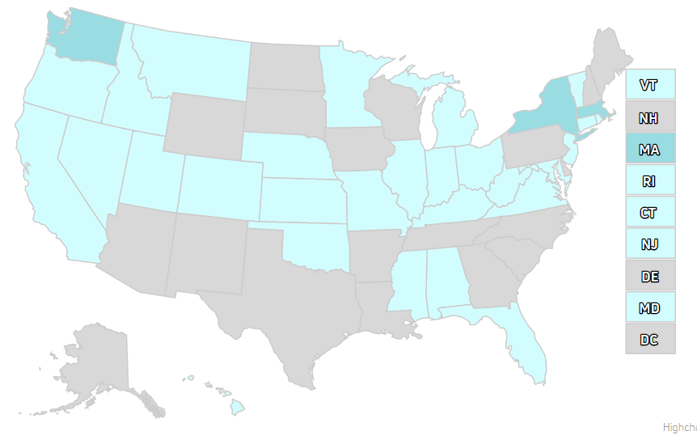
Everyone has a Role to Play
Connect with your local Crisis Center and consider volunteering or explore paid opportunities
Educate State and Federal Policymakers on importance funding, suicide prevention, and crisis services
Share accurate information on 988Lifeline with your network

Slide 26
Quick Links
988 Messaging Framework: This resource provides general guidance about when and how to develop messaging about 988.
#BeThe1To: Campaign for National Suicide Prevention Month and beyond, spreading the word about actions we can all take to prevent suicide.
English and Spanish Social Media Toolkit
SAMHSA 988 Partner Toolkit: Key Messages, FAQs, Printable material and more to speak with one voice to ensure there is a clear understanding about 988.
Vibrant Policy Newsletter: Monthly newsletter for 988 policy
988Jobs: Volunteer and Paid Opportunities

Slide 27
THANK YOU for all you do to support people in crisis
and for promoting 988 as a life-saving resource.

