Slide 1

HOW TO BE MORE LOVING
LISA FIRESTONE, PH.D.

Slide 2

Three Parts to this Webinar:
Part 1:
What Does It Mean to Be Loving?
Part 2:
What Gets in Our Way
Part 3:
What Can You Do About It?

Slide 3

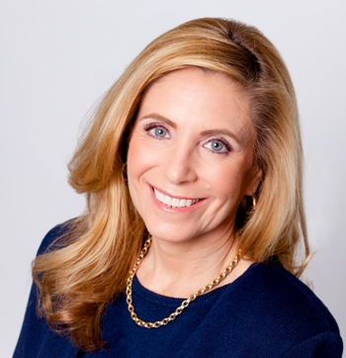
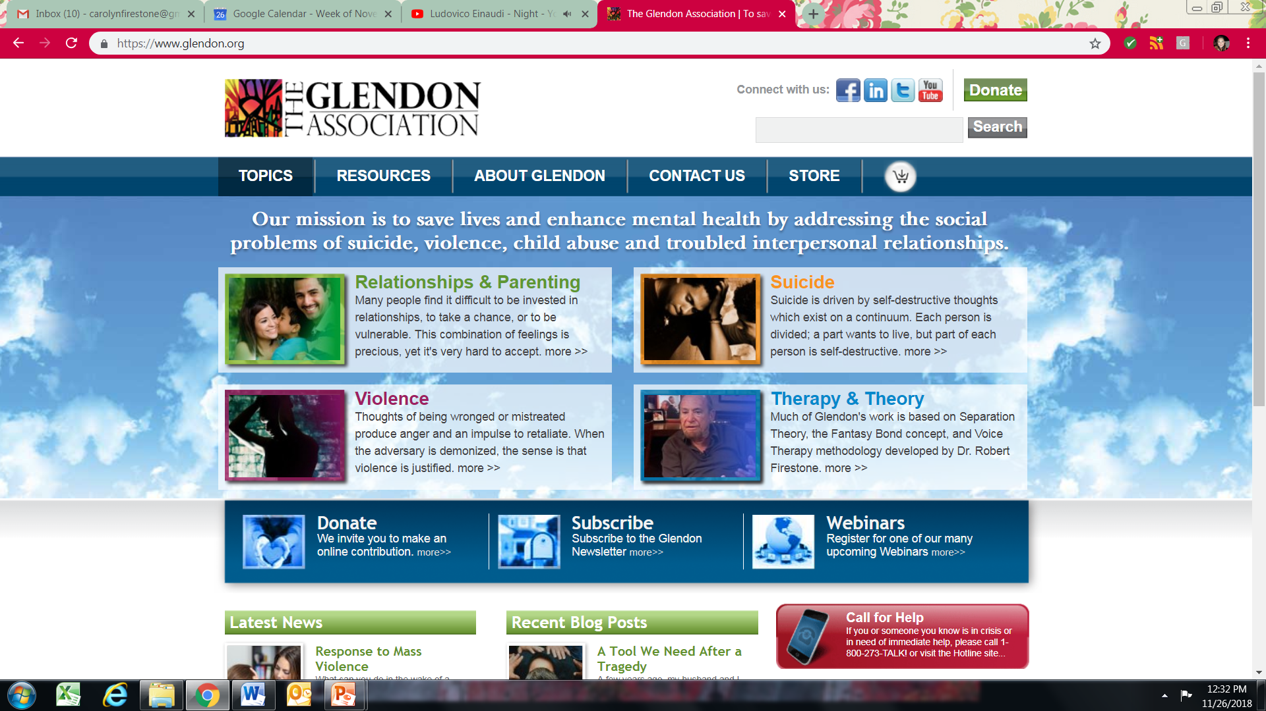
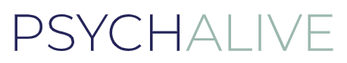
Lisa Firestone, Ph.D.
Director of Research and Education - The Glendon Association
Senior Editor - PsychAlive

Slide 4

Part 1
What does it mean to be loving?

Slide 5
There is only one proof for the presence of love: the depth of the relationship, and the aliveness and strength in each person concerned; this is the fruit by which love is recognized.
- Erich Fromm

Slide 6
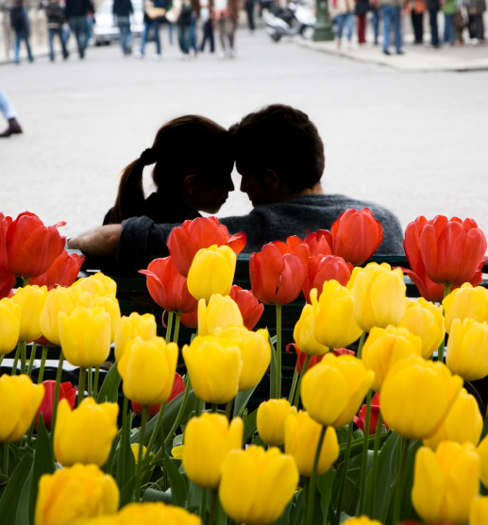
Our Definition of Love
“Defining love in behavioral terms is a challenging undertaking.”
Expressions of affection, physical and emotional
Wish to offer pleasure and satisfaction
Tenderness, compassion, and sensitivity to needs
Desire for shared activities and pursuits
Appropriate level of sharing of one’s possessions
Ongoing, honest exchange of personal feelings
Process of offering concern, comfort, and outward assistance for aspirations
Includes feeling for the other that goes beyond a selfish or self-centered interest
Nurtures and has a positive effect on each person’s self-esteem and sense of well-being.
Never involves deception

Slide 7

Love is a learned ability.
It is not inherent.
Studies show if you take more loving actions, you feel more loving feelings.

Slide 8
Romantic Love
vs. Passionate or Companion-like Love
Romantic Love
Characterized by intensity, engagement and sexual interest
Associated with marital satisfaction, well-being, high self-esteem, relationship longevity
Passionate/Obsessive Love
Same features as romantic love but also includes feelings of uncertainty and anxiety
Works well in short-term relationships but hurts long-term relationships
Companion-like Love
Only moderate satisfaction in both short-term and long-term relationships
Source: http://carolinaneuroscience.web.unc.edu/files/2013/01/Acevedo-et-alLong-term-romantic-love.pdf

Slide 9
Romantic Love
vs. Passionate or Companion-like Love
Study found that romantic love can last in a long-term relationship and keep both people happy.
Source: http://carolinaneuroscience.web.unc.edu/files/2013/01/Acevedo-et-alLong-term-romantic-love.pdf

Slide 10
Romantic Love
vs. Passionate or Companion-like Love
“Couples should strive for love with all the trimmings…Couples who’ve been together a long time and wish to get back their romantic edge should know it is an attainable goal that, like most good things in life, requires energy and devotion.”
- Bianca P. Acevedo, Ph.D.
Source: http://carolinaneuroscience.web.unc.edu/files/2013/01/Acevedo-et-alLong-term-romantic-love.pdf

Slide 11

Love is not:
What we mean when told “Mommy or Daddy really loves you, but he or she just doesn’t know how to show it.”
Selfish, possessive, or demanding, or a proprietary right over the other
Submission or dominance, emotional coercion or manipulation
Desperate attempt to deny aloneness or the search for security manifested in a desire for a fused identity
Emotional hunger, a desperate, immature need for dependence on another that drains their vitality
A deep longing to find total confirmation of oneself in the other
A word to be bandied about in a collusive attempt to maintain control of one another
An inner state of mind with no outward manifestations

Slide 12
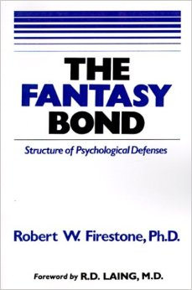
Definition of Fantasy Bond
A Fantasy Bond is an illusion of connection, originally an imaginary fusion or joining with the parent. We use the term Fantasy Bond to describe both the original imaginary connection formed during childhood and the repetitive efforts of the adult to continue to make these types of connections in intimate relationships.

Slide 13
Differentiation and Linkage
Linkage
(emotional closeness)
Differentiation
(individuation as an individual)

Slide 14

Part 2
What gets in our way

Slide 15
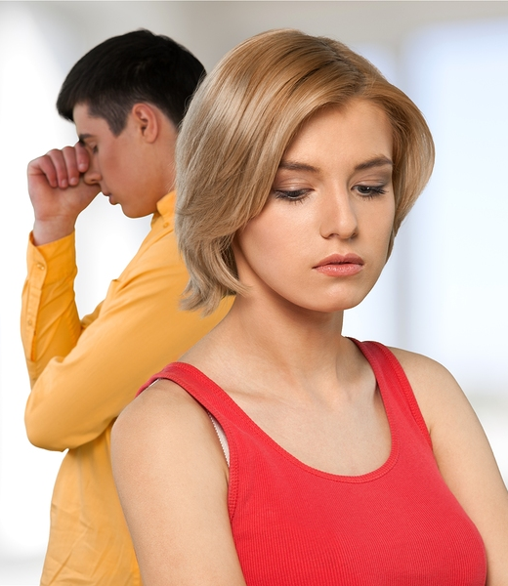
Separation Theory
Attachment Theory
Emotion-focused Therapy

Slide 16
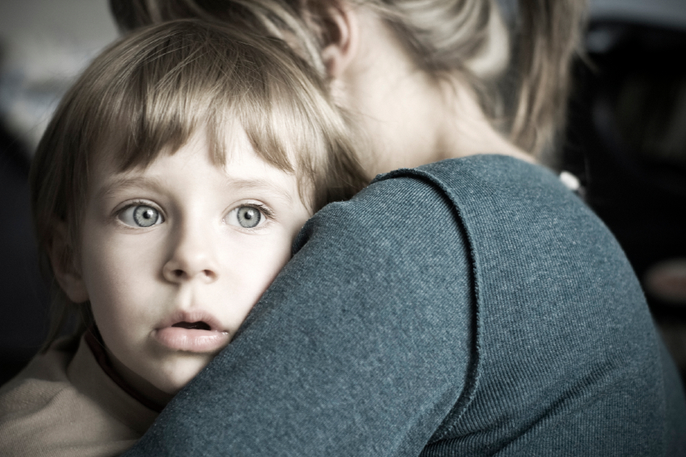

Slide 17
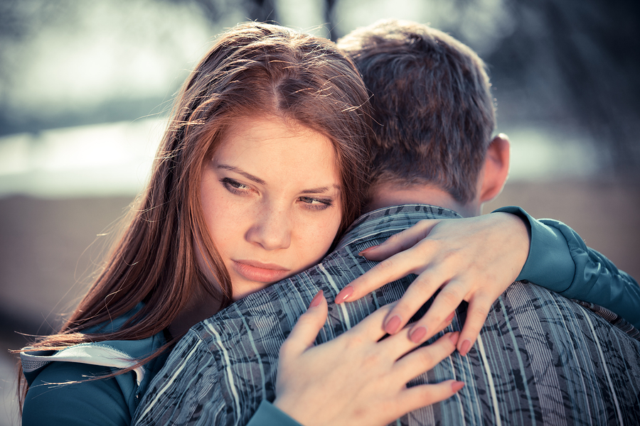
Fear of Intimacy
Interpersonal relationships are the ultimate source of happiness or misery. Love has the potential to generate intense pleasure and fulfillment or produce considerable pain and suffering.
- From Sex & Love in Intimate Relationships

Slide 18


Reasons We Defend Against Love
What are we afraid of?
Arouses anxiety and makes us feel vulnerable
Arouses sadness and painful feelings from the past
Provokes a painful identity crisis
Disconnects people from a “fantasy bond” with their parents
Arouses guilt in relation to surpassing a parent
Stirs up existential issues

Slide 19
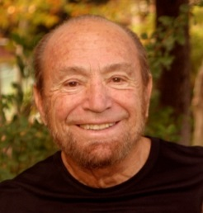

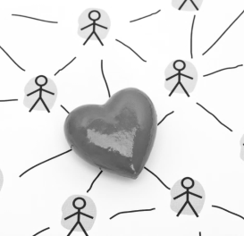

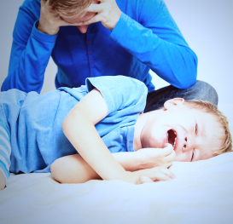

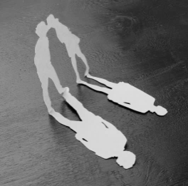

Separation Theory
Robert W. Firestone, Ph.D.
Core Conflict:
Integrates psychoanalytic and existential systems of thought
Two kinds of emotional pain:
UNDEFENDED
DEFENDED
INTERPERSONAL
EXISTENTIAL
FANTASY BOND
CRITICAL INNER VOICE

Slide 20

Origins of a Fantasy Bond
Illusion of connection originally formed with parent to help relieve early anxiety and emotional pain
Process of self-parenting - see and treat ourselves the way we were seen and treated, both punishing and soothing ourselves
Fantasy bond extends to our adult relationships
Defenses we form limit our capacity for real love and closeness

Slide 21
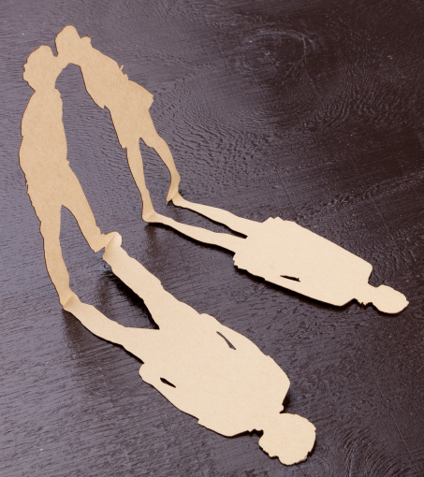
The Fantasy Bond
Illusion of connection that is substituted for feelings of real love
Often unconscious act of self-parenting and self-protection
  Pseudoindependence
  Form replaces substance
Degree of reliance on a fantasy bond is proportional to the degree of frustration and pain in a person’s developmental years

Slide 22
Do you have a fantasy bond with your partner?
Withhold, punish or criticize your partner?
Have rigid behavior patterns?
No longer engage in loving actions?
Take your partner for granted?
Relate as a unit?
Feel like you can’t live without partner?

Slide 23
Fantasy Bond on a Continuum
Less connection – more distancing and withholding behaviors or taking partner for granted
Hating each other – overt nastiness or complete dependency
More criticism and projections of parent onto partner
Separations or settling for living distantly together or totally merged identity
Settling into routine, deadening behaviors
Fantasies about who partner is

Slide 24
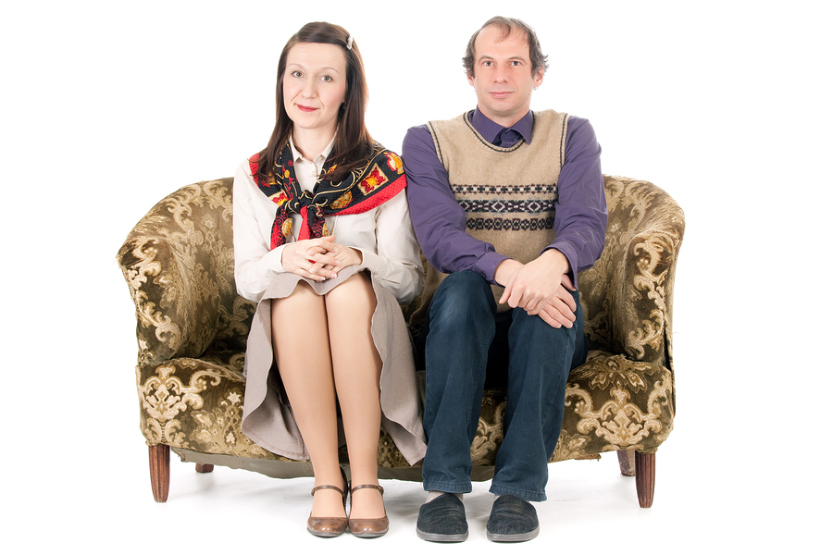
Love breaks a “Fantasy Bond” with our parents
Relationships:
Ultimate symbol of growing up
Represent starting our own lives
Symbolize a parting from our family
Letting go on an emotional level
Differentiating from negative dynamics that plagued our early relationships and shaped our identity

Slide 25
“When we think we have been hurt by someone in the past, we build up defenses to protect ourselves from being hurt in the future. So the fearful past causes a fearful future and the past and the future become one.”
- Alfred Hitchcock

Slide 26

Psychological Defenses
Being loved by someone we love and admire threatens our defenses.
Habits we’ve long had that allow us to feel safe, self-focused or self-contained
Adaptations to our early environment that aren’t adaptive in our adult lives

Slide 27

As adults, people’s defenses may lead them to:
Repeat patterns they saw in their parents
Choose someone similar to a person from their past
Recreate familiar relationship dynamics
Engage in unhealthy defenses formed as adaptations to painful events

Slide 28
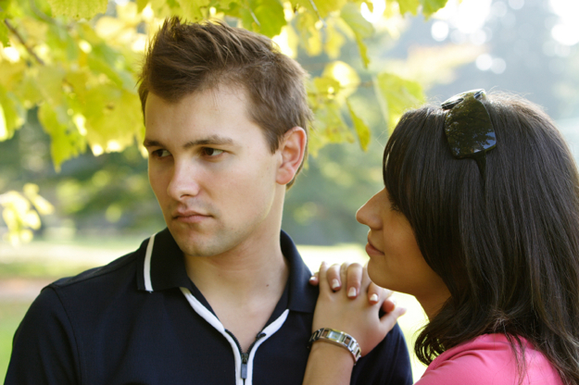


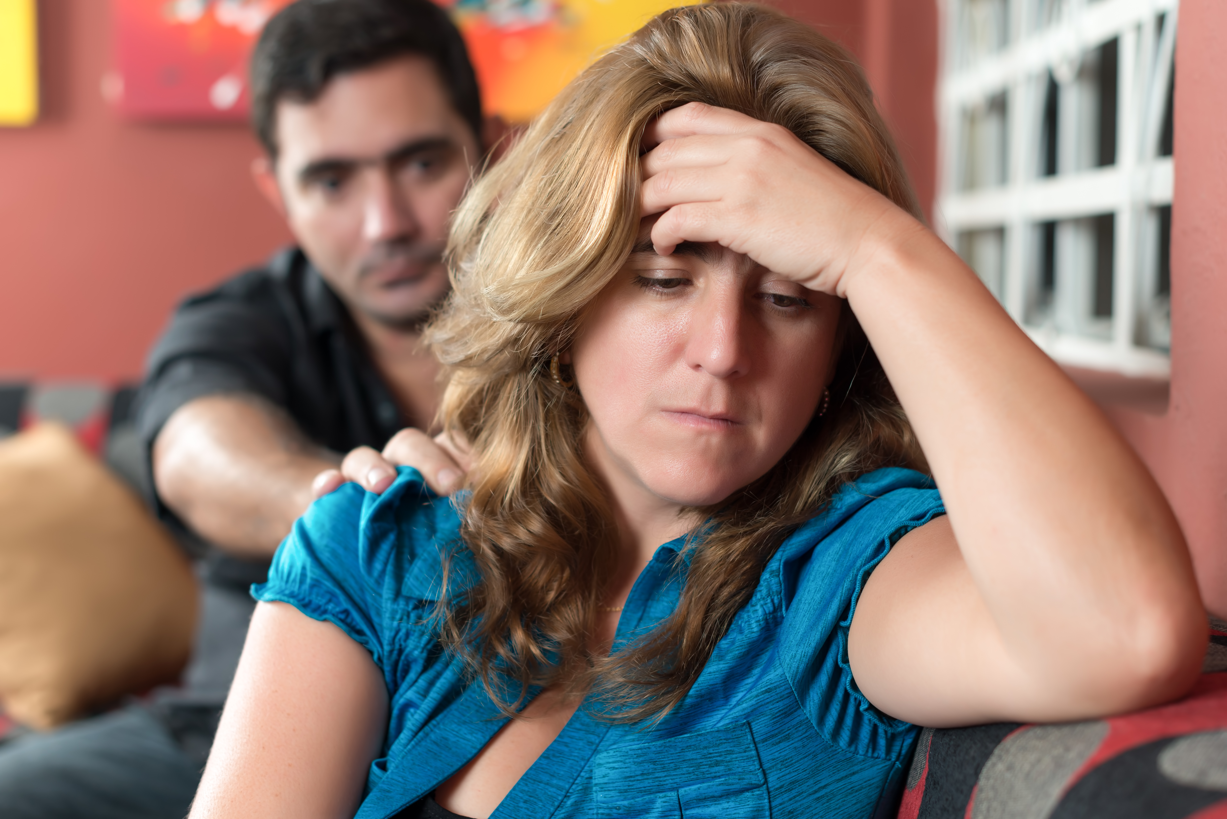
Possible Signs of Poor Selection:
Exaggerated magnetism
Sense of completion (i.e. finding your “missing piece”)
Mimics your past (stirs up old feelings)
Thoughts that you can alter or save the person

Slide 29

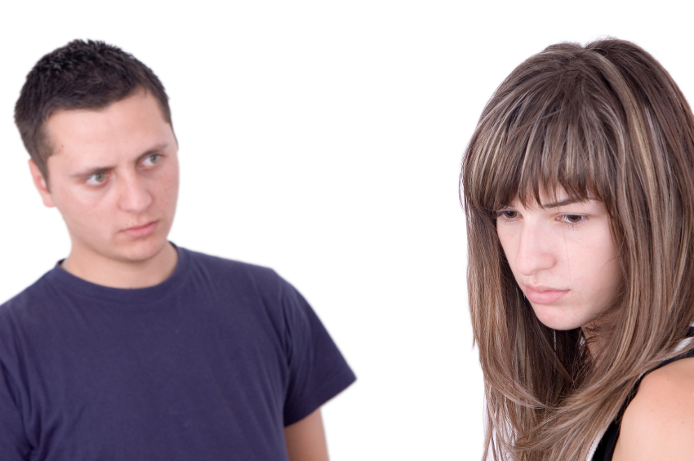
Distortion:
Why do we distort our partners?
We tend to distort at points when we become anxious:
Reaction to acting against our defenses
Reaction to love directed toward us
Fear of intimacy, defense against closeness
Fear of loss

Slide 30
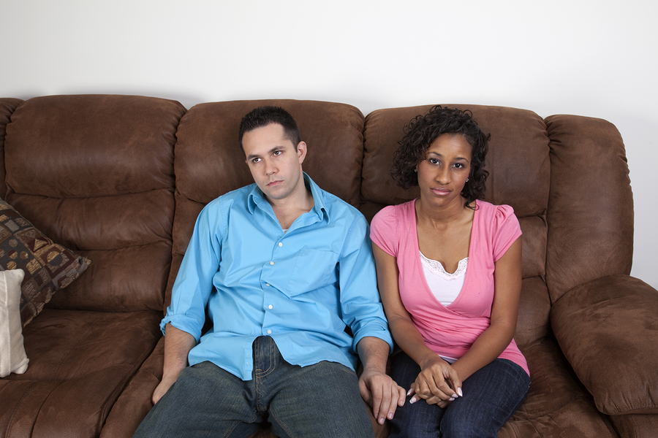

Provocation:
Why do we provoke our partners?
Reaction to breaking with an old identity
Pain of getting what we’ve always longed for
Challenges defenses
Discomfort of emotional closeness

Slide 31
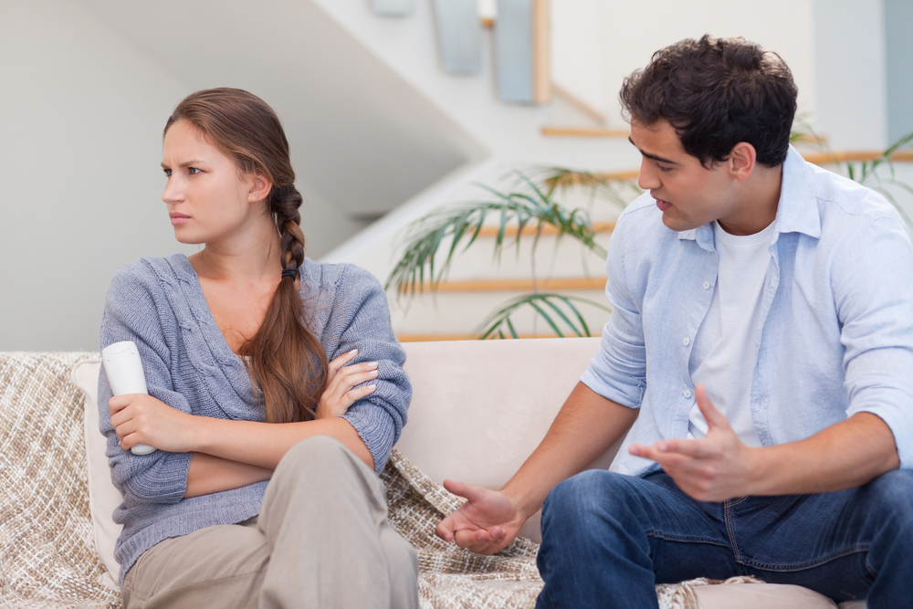

Provocation:
We create our own worst nightmare
Get them to voice our critical inner voice
Act in ways that push them away
Get them to treat us in ways we were treated

Slide 32
The Critical Inner Voice
The Language of the Defensive Process
Well-integrated pattern of destructive thoughts toward ourselves and others
At the root of much of our maladaptive behavior
Fosters inwardness, distrust, self-criticism, self-denial, addictions and a retreat from goal-directed activities
Affects every aspect of our lives: our self-esteem and confidence, and most importantly, our personal and intimate relationships

Slide 33

How the Voice Process
Impacts Relationships
Self-Punishing Voice Process in Relationships:
EXAMPLE: “You can’t make anyone happy. You’re so unlovable. He/She will never care about you. You’ll just wind up alone.”
Self-Soothing Voice Process in Relationships:
EXAMPLE: “You are just fine on your own. You can take care of yourself. You don’t need anyone else. Don’t trust him/her.”
Notes:
33

Slide 34

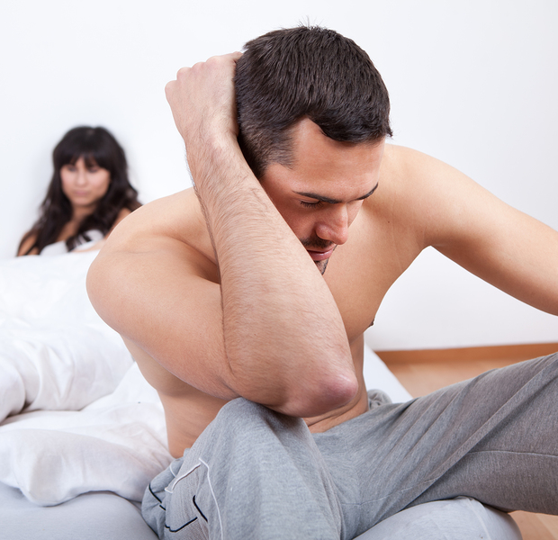
Common “Voices” in Relationships
Voices About Yourself:
Don’t get too hooked on her.
He doesn’t really care about you.
She is too good for you.
You’re better off on your own.
As soon as he gets to know you, she’ll reject you.
Don’t be too vulnerable. You’ll just get hurt.
Voices About Your Partner:
You shouldn’t be vulnerable.
She only cares about being with her friends.
He is probably cheating on you.
She’s too needy.
He’s going to leave you.
?
?

Slide 35


Slide 36

How do I get these people to take care of me?

Slide 37


Understanding Attachment
Attachment patterns are formed in infancy, during the first two years of life.
Once established, it is a pattern that affects us throughout our lives, particularly in how we relate in intimate relationships and with our children.

Slide 38

Internal Working Models
Our early relationships provide a template for how relationships go. Can I depend on others? Will they soothe me when I need it? Will they see me for who I really am?

Slide 39
Adult attachment ‘styles’:
Regions in a two-dimensional space
HIGH AVOIDANCE
DISMISSING AVOIDANT
FEARFUL AVOIDANT
LOW ANXIETY
HIGH ANXIETY
PREOCCUPIED
SECURE
LOW AVOIDANCE
From: “Secure and Insecure Love: An Attachment Perspective” Phillip R. Shaver, Ph.D.
Adapted from Ainsworth et al. (1978), Bartholomew & Horowitz (1991), Fraley & Shaver (2000)

Slide 40
Is Your Attachment Style Affecting Your Relationship?
Secure Attachment:
Tend to be more satisfied in their relationships
Preoccupied Attachment: Tend to be desperate to form a fantasy bond. Instead of feeling real love or trust toward their partner, they often feel emotional hunger

Slide 41
Is Your Attachment Style Affecting Your Relationship?
Dismissive Attachment:
Have the tendency to emotionally distance themselves from their partner
Fearful-Avoidant Attachment:
Live in an ambivalent state in which they’re afraid of being too close to or too distant from others

Slide 42

Attachment and Relationships
Attachment anxiety and avoidance are related to deficits in caring for relationship partners and engaging in altruistic behavior. (e.g., Kunce & Shaver, 1994; Gillath et al., 2005).
Preoccupied people tend to be self-focused when engaged in supposedly caring/altruistic actions, leading to intrusiveness, poor assessment of others’ actual needs, and personal distress.
Dismissive people tend to be less interested in helping others and to derogate needy others. They are relatively deficient in the domain of compassion and love.
From: “Secure and Insecure Love: An Attachment Perspective” Phillip R. Shaver, Ph.D.

Slide 43
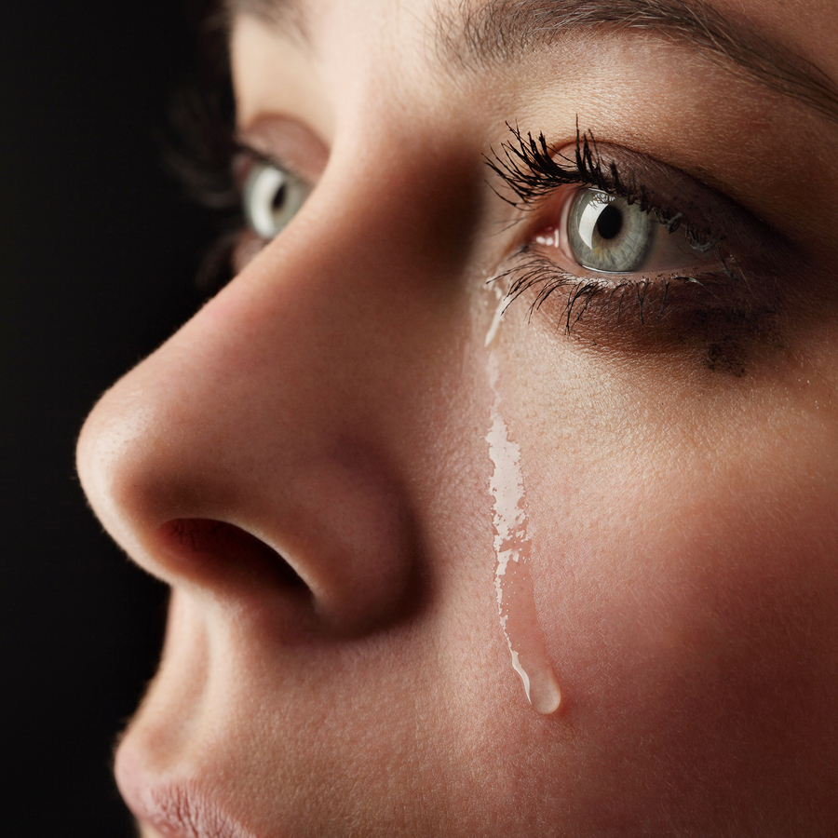

Slide 44
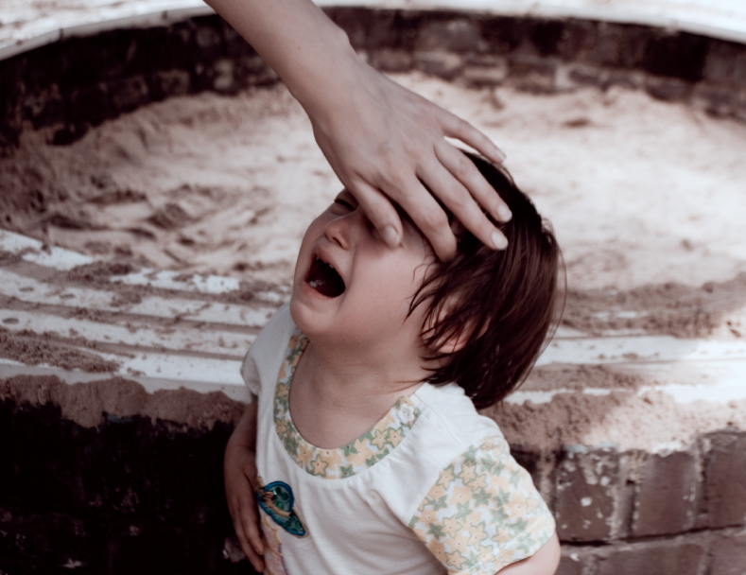
adaptive
Fear
maladaptive

Slide 45

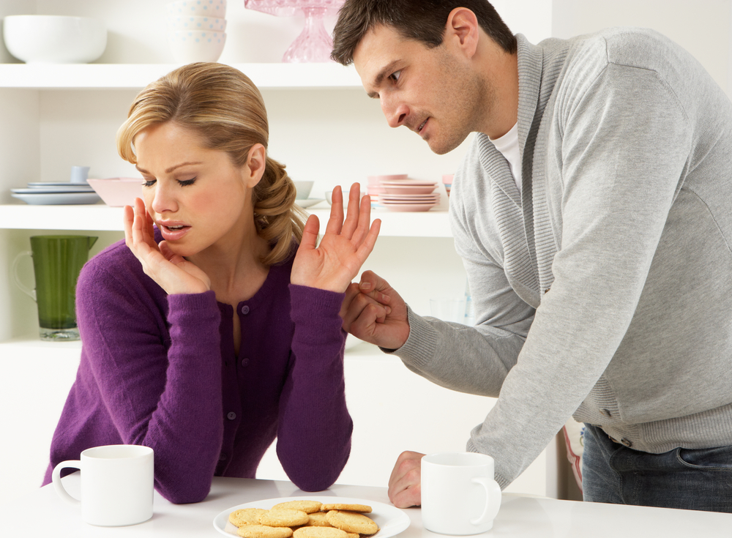
adaptive
Anger
maladaptive

Slide 46


Where maladaptive emotions come from
How we develop negative schemas

Slide 47
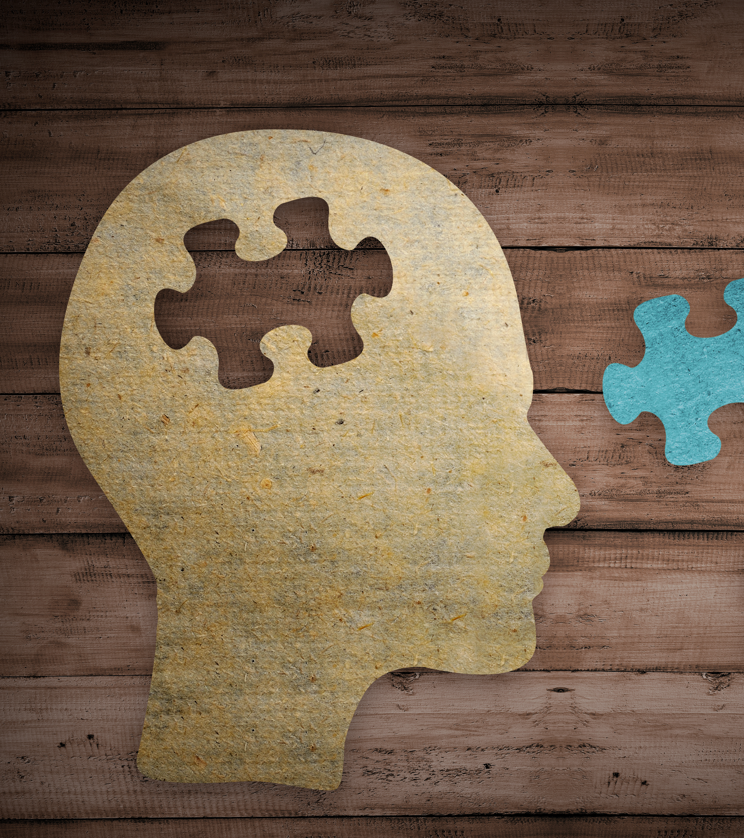
Schemas:
Experiences we have become schemas (feelings, actions, beliefs)
Develop while growing up
Triggered by current events
Lead to maladaptive reactions

Slide 48

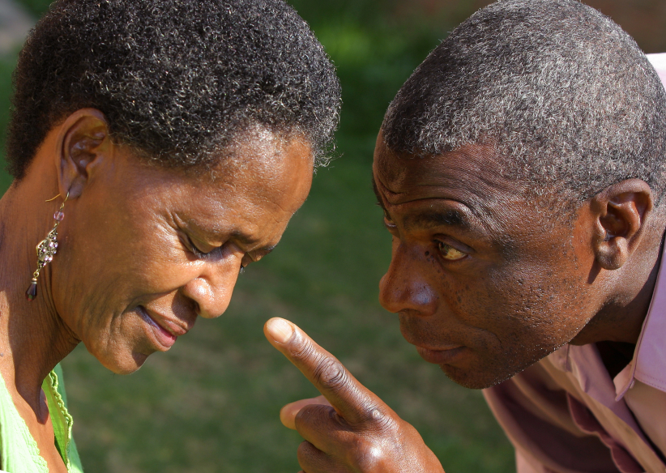
Two Main Conflicts
Attachment
Pursuer/ Distancer
Identity
Dominant/ Submissive

Slide 49

Perpetuating Cycles
Both partners push or provoke in ways that encourage the other person to play the other half of old, familiar dynamics.
Relationship starts to look more like those of their past.
Reinforces each partner’s working model, confirming what they already believe about love and relationships.

Slide 50

Part 3
What can you do about it?

Slide 51
Your task is not to seek for love, but merely to seek and find all the barriers within yourself that you have built against it.
-Rumi

Slide 52


Recognize and admit you have a fantasy bond
Take steps to break a fantasy bond

Slide 53

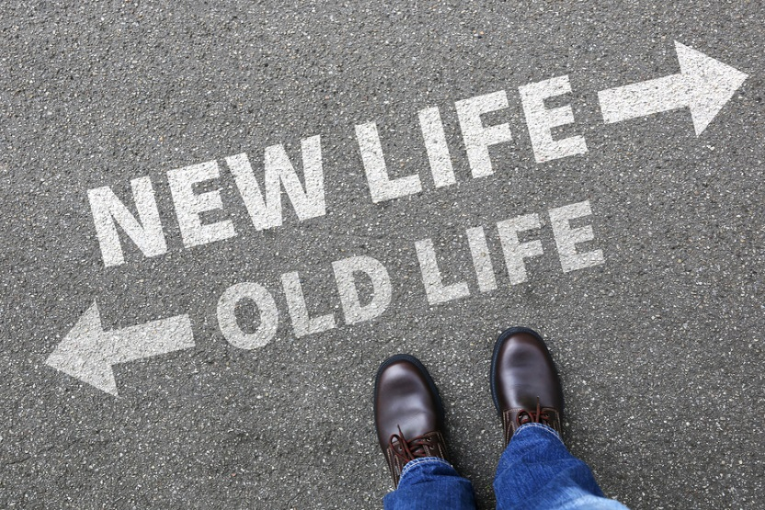
To break free from a fantasy bond we must:
Leave our own inward world and challenge our self-nourishing and punishing habits
Redirect our energy toward taking chances on finding satisfaction in the external world through goal-oriented behavior

Slide 54


Actions that counter a
fantasy bond:
Express love in a way your partner would experience as loving.
Be affectionate.
Slow down. Be kind and present.
See partner for who they are.
Make eye contact.
Try something old.
Try something new.
Break routine.
Avoid passivity and control.
Talk as an “I” instead of a “we.”
Be aware of your critical inner voice.

Slide 55
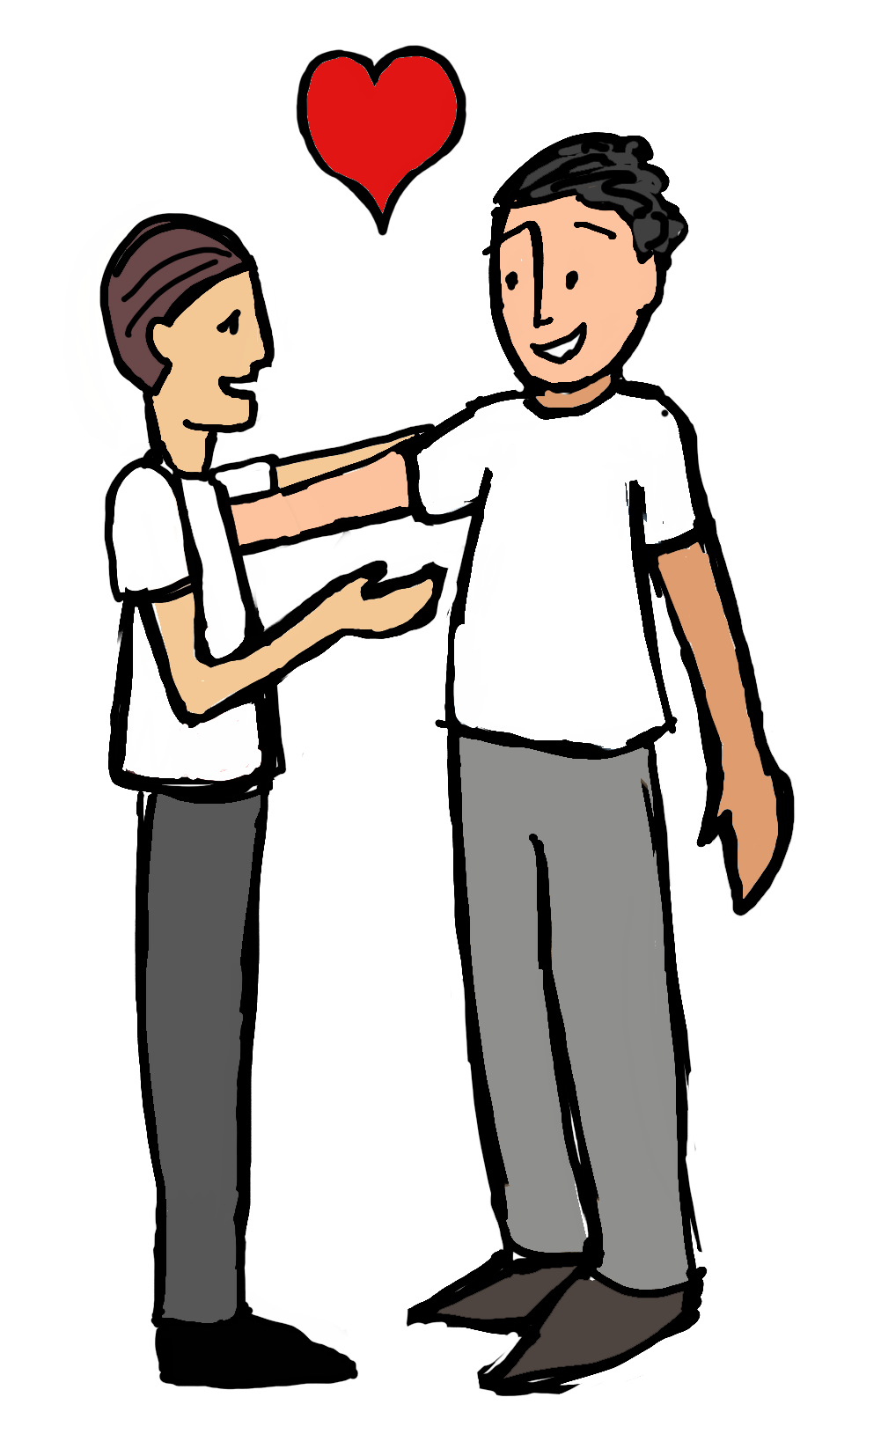
Relate and interact!
Ask questions.
Joke around.
Listen.
Talk personally.
Express interest.
Continue to let your
partner know you.
Continue to get to
know your partner.
From “Daring to Love” with Tamsen Firestone

Slide 56
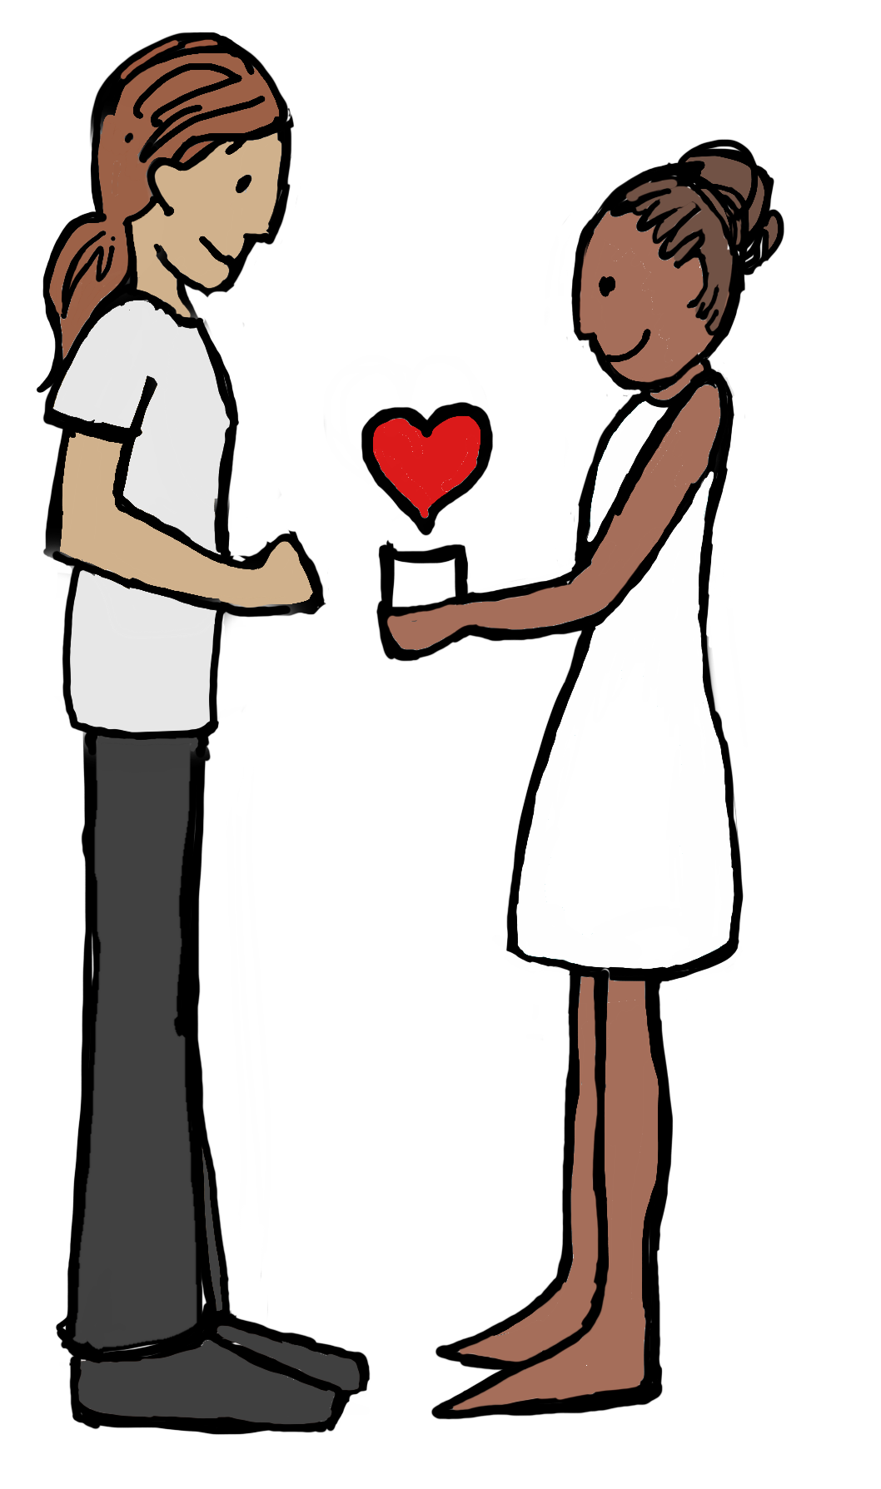
Be generous!
Notice when something
is needed
Offer an ear to listen
or a shoulder to lean on
Lend a helping hand
Make a thoughtful
gesture
Give a sensitive gift
From “Daring to Love” with Tamsen Firestone

Slide 57
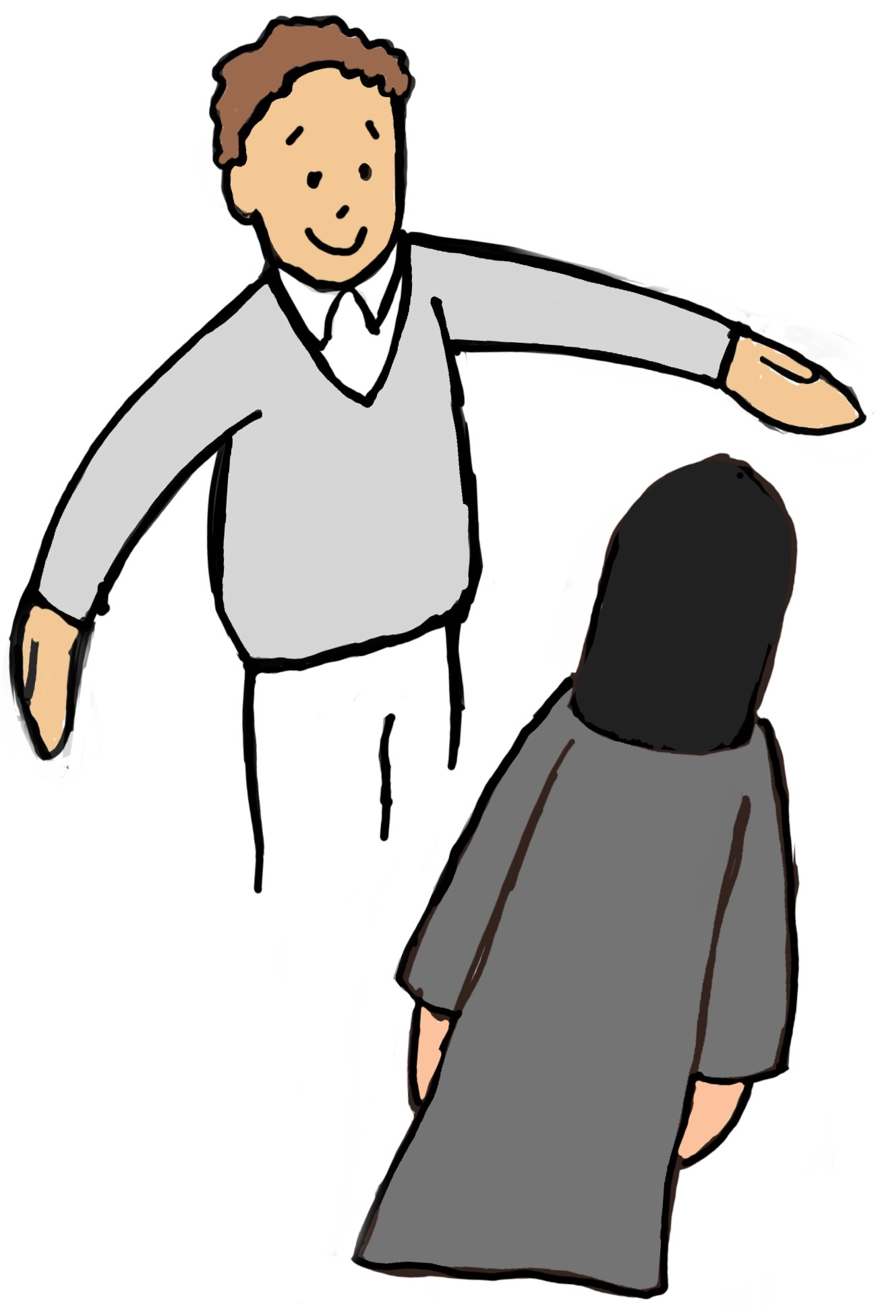
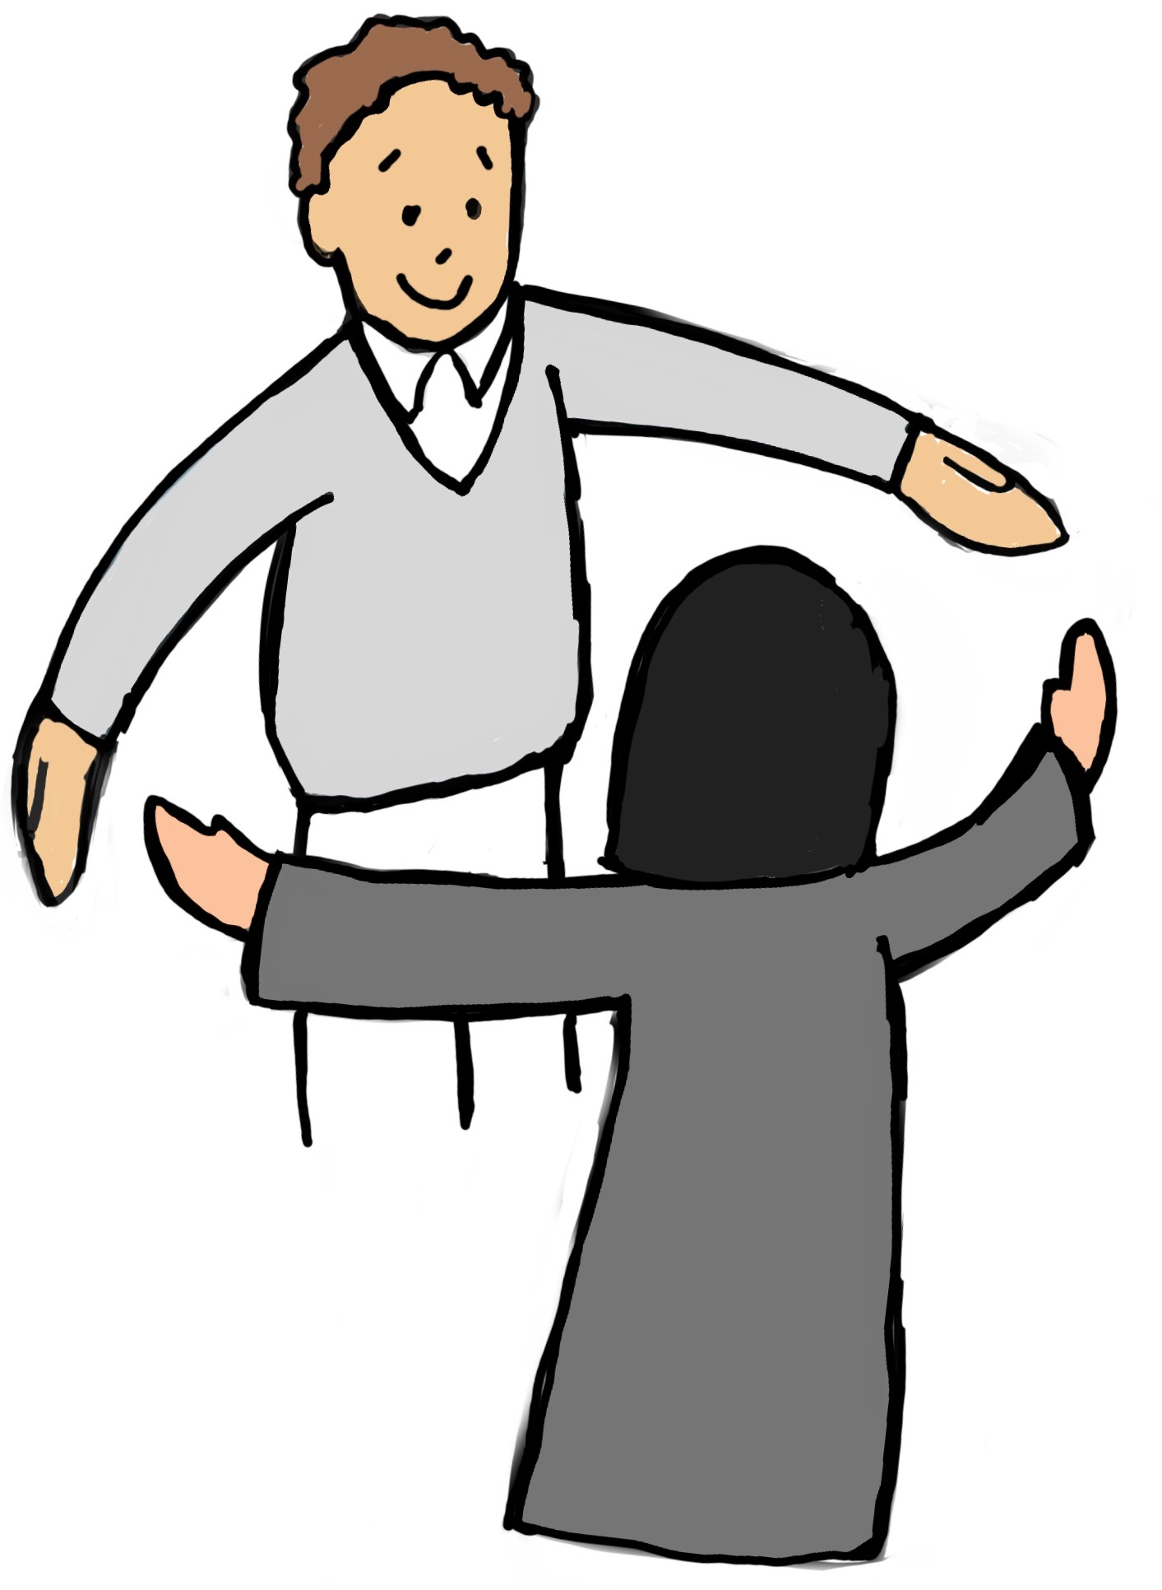
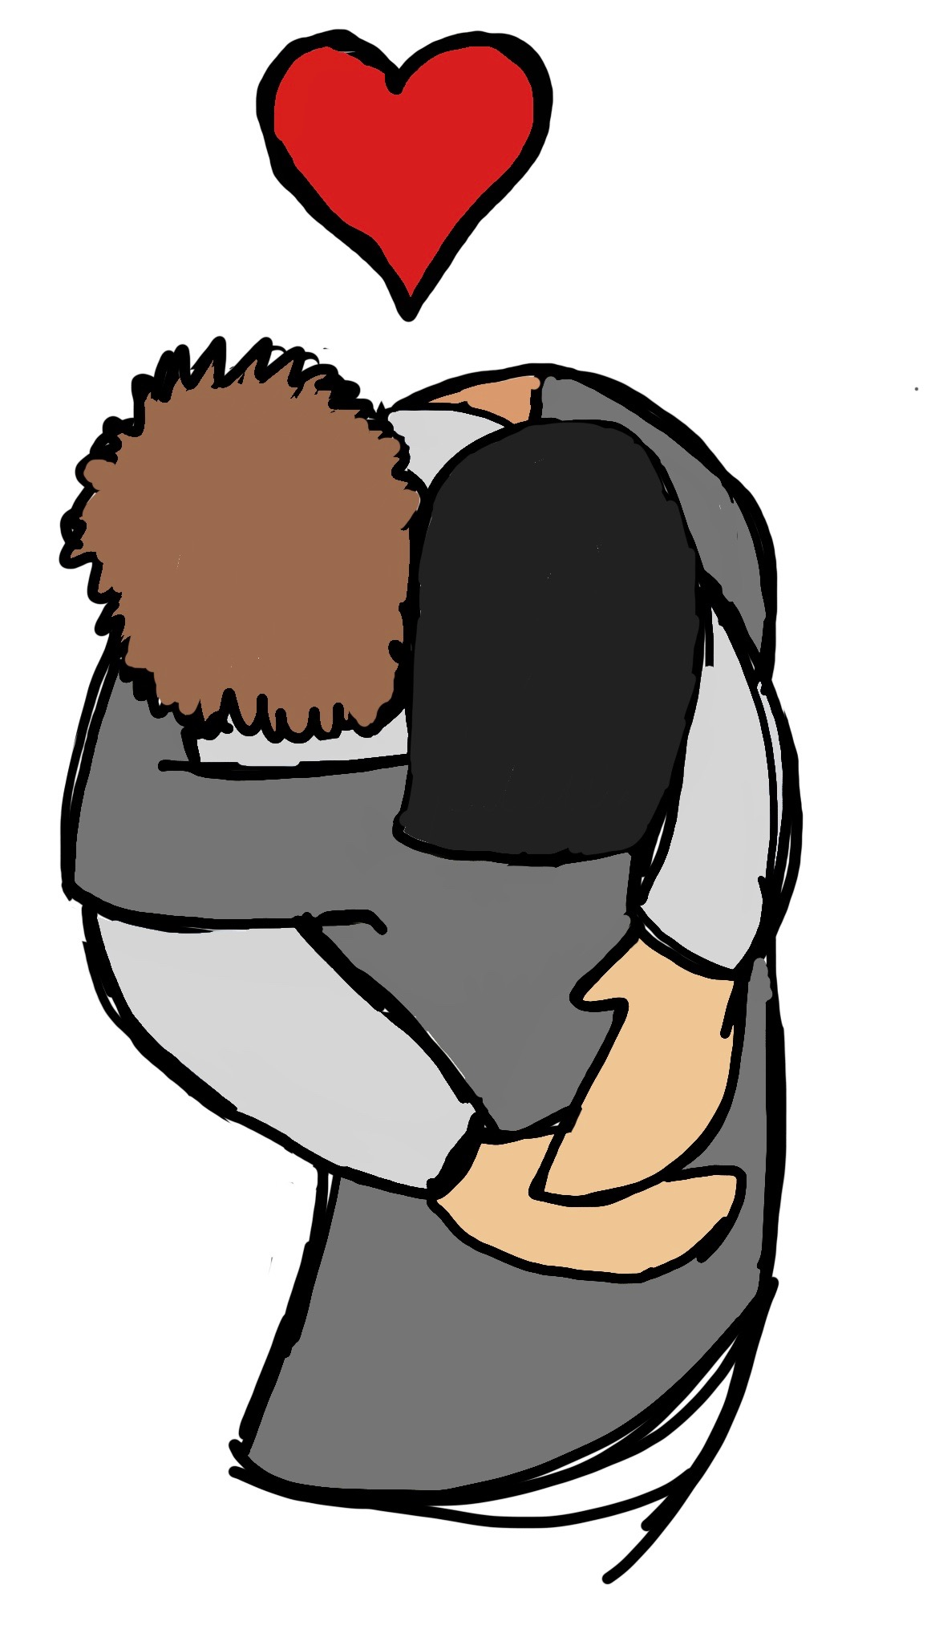
Express affection!
Accept affection!
From “Daring to Love” with Tamsen Firestone

Slide 58
Taking Responsibility for
Your Half of the Dynamic
Think about what your partner does that you don’t like.
Then, think about what you do right beforehand.

Slide 59
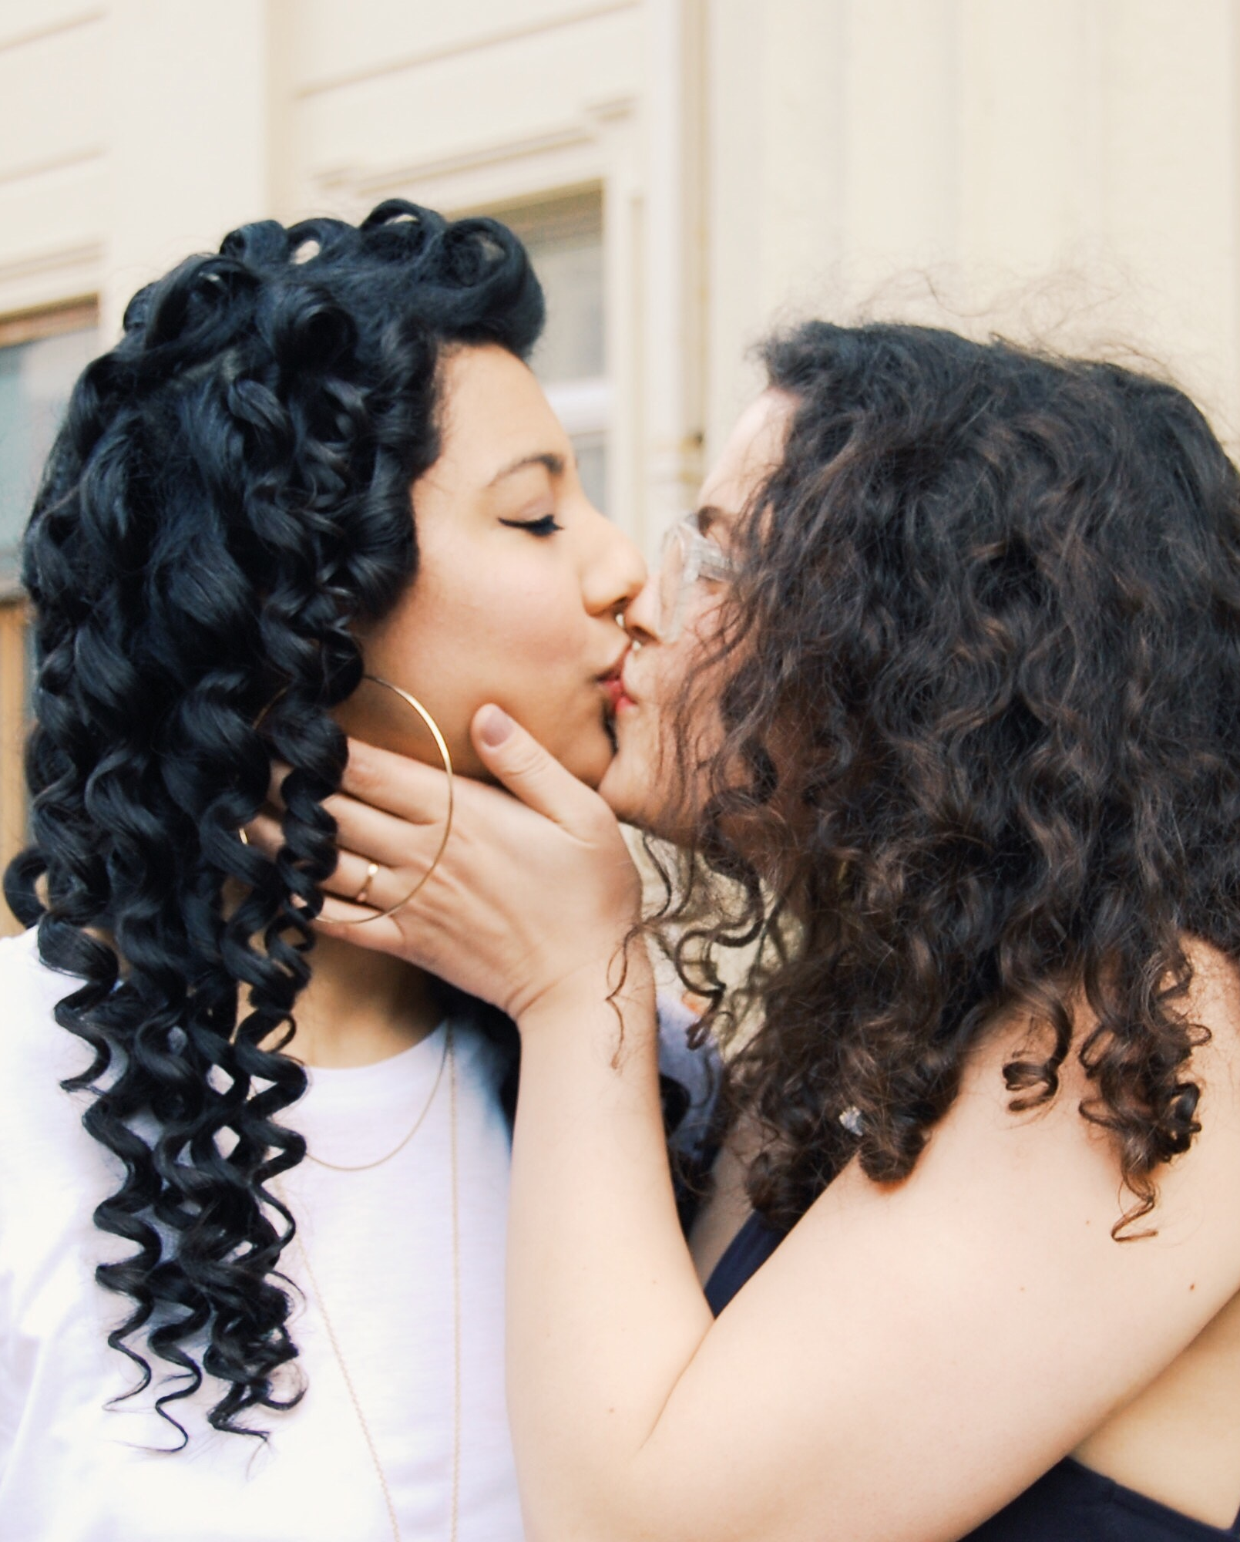
Goals for Your Relationship
Write down any goals you have for yourself and what kind of relationship you want. What would the relationship look like? Do you want more closeness? More independence?
How could you go about achieving these goals? List the actions you will take.
What actions will you take when you feel triggered? How can you return to the underlying want?
How will you express this want to your partner?
What actions will you take to make your partner feel understood?

Slide 60

Unilateral Disarmament
The technique of Unilateral Disarmament does not imply that you are surrendering your point of view, taking the blame or deferring to your partner’s opinion. It simply indicates that you value being close to your partner more than winning your point.

Slide 61
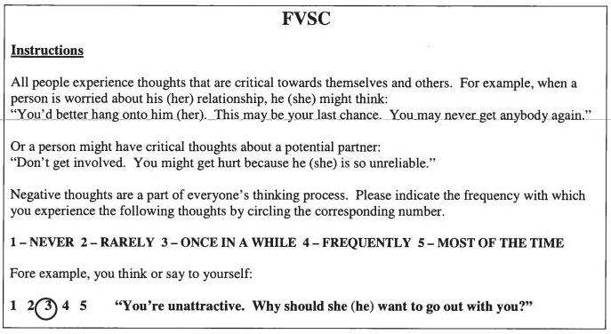
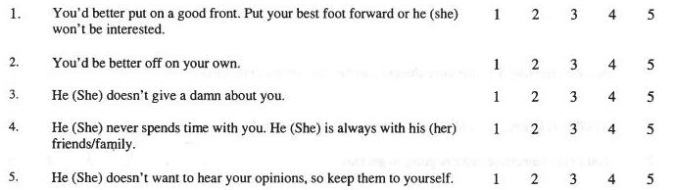
The Firestone Voice Scale for Couples

Slide 62
You in Your Relationship:
Your Critical Inner Voice/The Real You
What my critical inner voice says about me in my relationship
___________________________
___________________________
___________________________
___________________________
What I realistically think about myself in my relationship
___________________________
___________________________
___________________________
___________________________

Slide 63
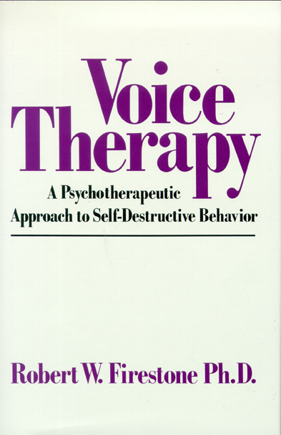
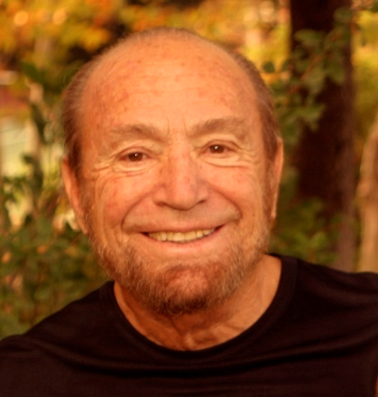
Voice Therapy
Cognitive/ Affective/ Behavioral Approach

Slide 64
Voice Therapy:
Steps in the Therapeutic Process with Couples
Formulating the problem
Verbalizing the voice and releasing affect
Developing insight about the source of the voice
Answering back to the voice
Developing insight about how voices are influencing behaviors
Planning corrective suggestions for changing behavior
Sharing voices with each other between sessions
If you are interested in attending a voice therapy training or in getting training materials please contact jina@glendon.org or visit www.glendon.org.

Slide 65

Developing
Secure Attachment
Relationship with a partner with a secure attachment pattern
Therapy
Coherent narrative

Slide 66
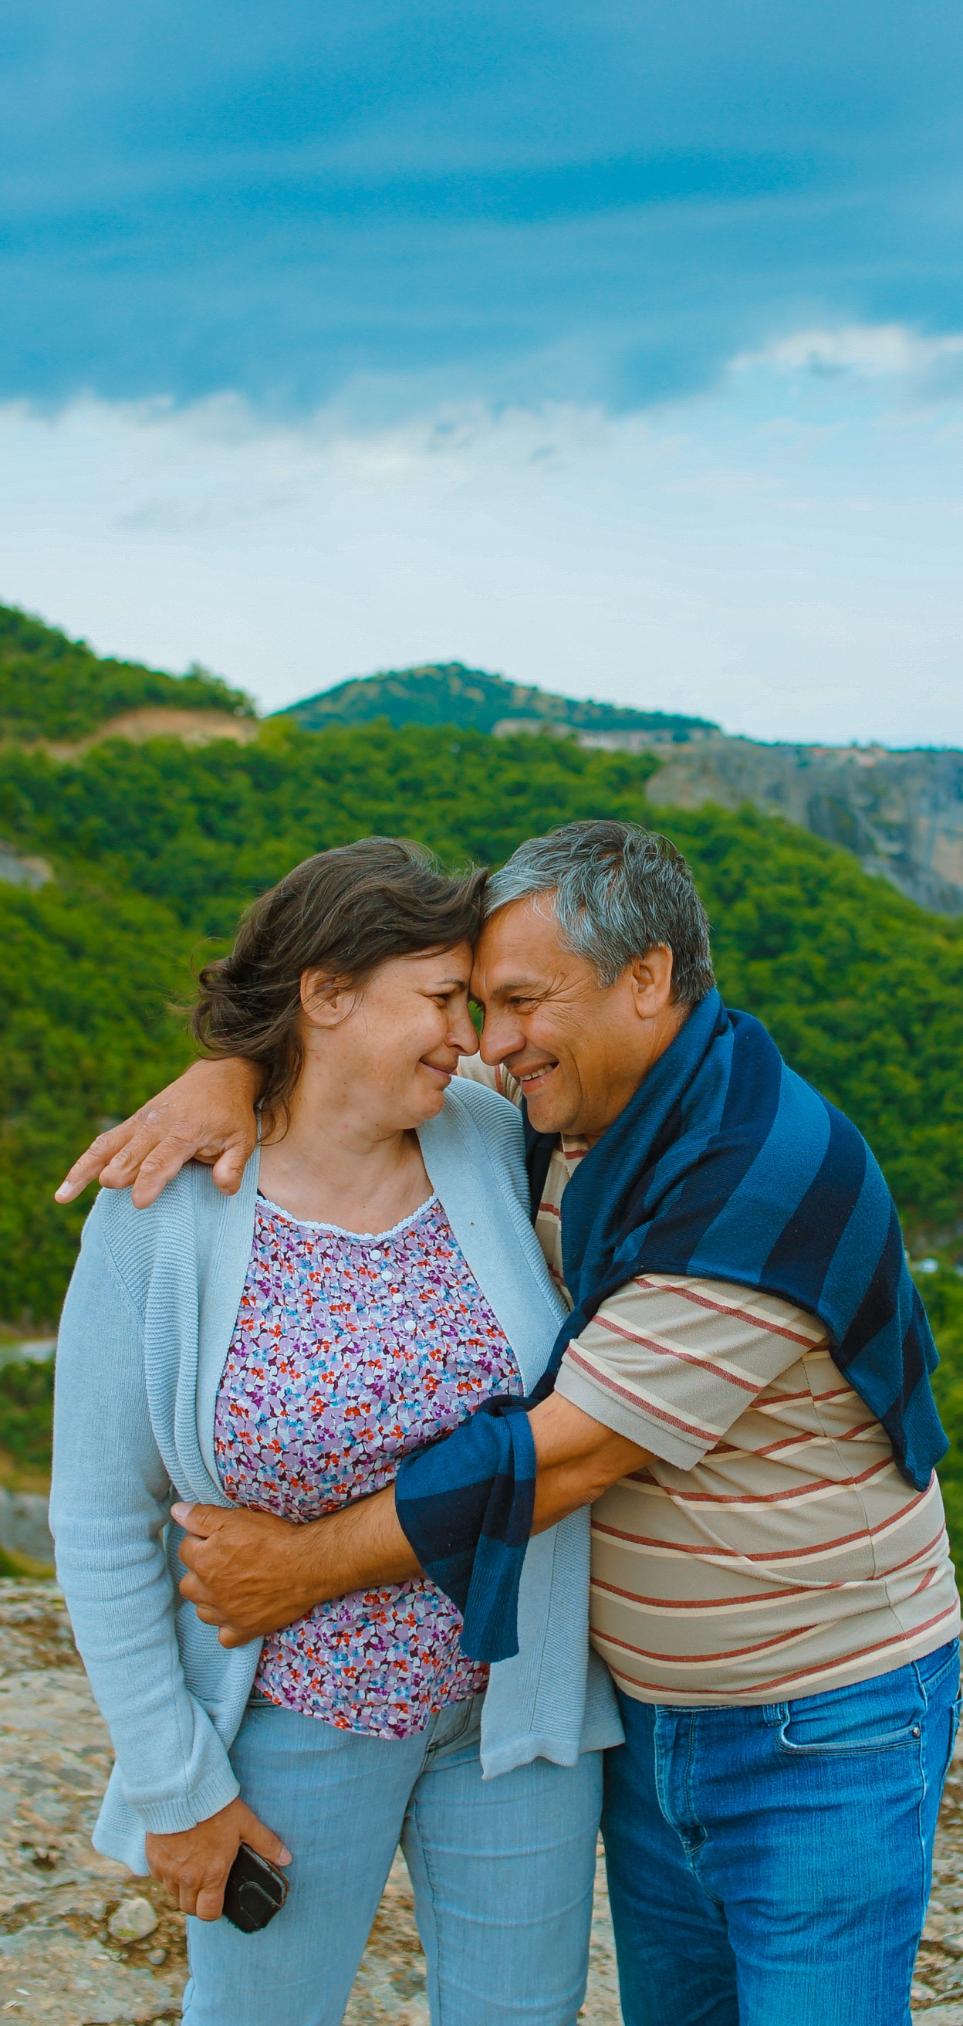
Transforming Emotions in Your Relationships
Identify unacknowledged emotions/ vulnerability (wants and needs) behind reactions
Express both the universal want/need and specific want/need
Helps the person feel more vulnerable, and the partner to respond with more feeling and sensitivity

Slide 67
Identifying and Changing Cycles
Emotions and Needs
A. Frustrating Patterns | B. Secondary Feelings | C. Reactive Patterns | D. Primary Emotion* (Fear/Shame/Sadness/Anger) | E. Needs Global/ Specific
When you… | I feel… | And react by… | This obscures my… | What I really want is…
Are late | Angry | Criticizing | Anxiety and feeling rejected | To feel important to you/ You to call
Fill in the following sentences with your emotions and needs.
When you...
I feel…
And react by…
This obscures my…
What I really want (generally) is…
What I really want (specifically) is…

Slide 68

Look Inside Yourself
If you’re single:
Think about the partners you select
Note if there are patterns to your selections
Ask yourself how you could break these patterns
Be open to dating outside your comfort zone
Give these opportunities a chance, even though they may make you feel uncomfortable at first

Slide 69
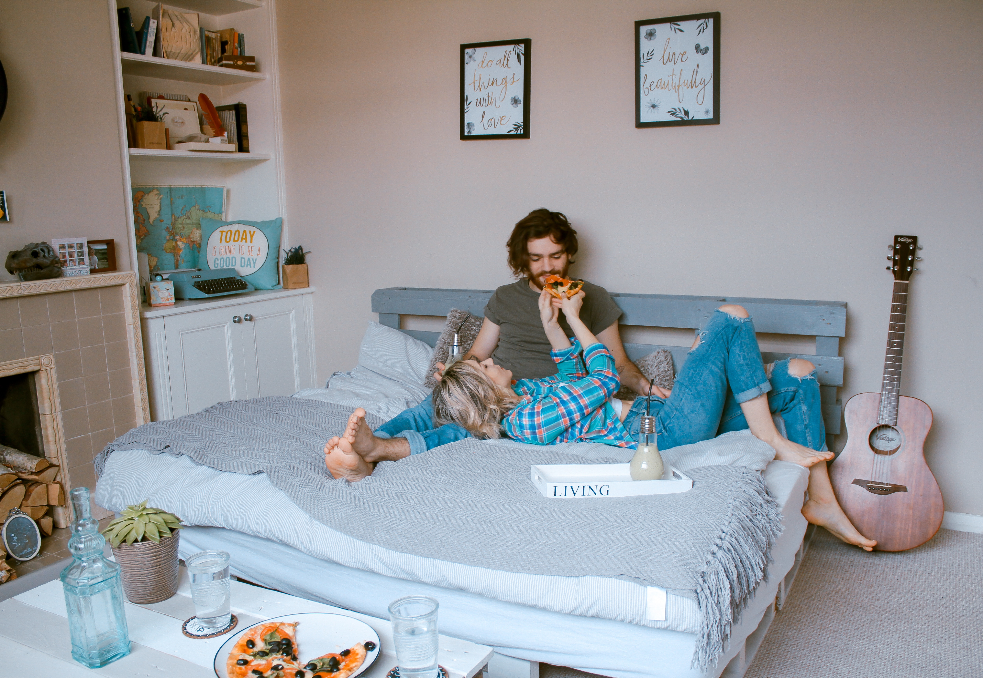
Look Inside Yourself
If you’re in a relationship:
If you polarize, do the opposite
Be open to new things
Think about how it feels and not how it looks
See partner and self through a realistic and compassionate perspective
Be open to feedback

Slide 70
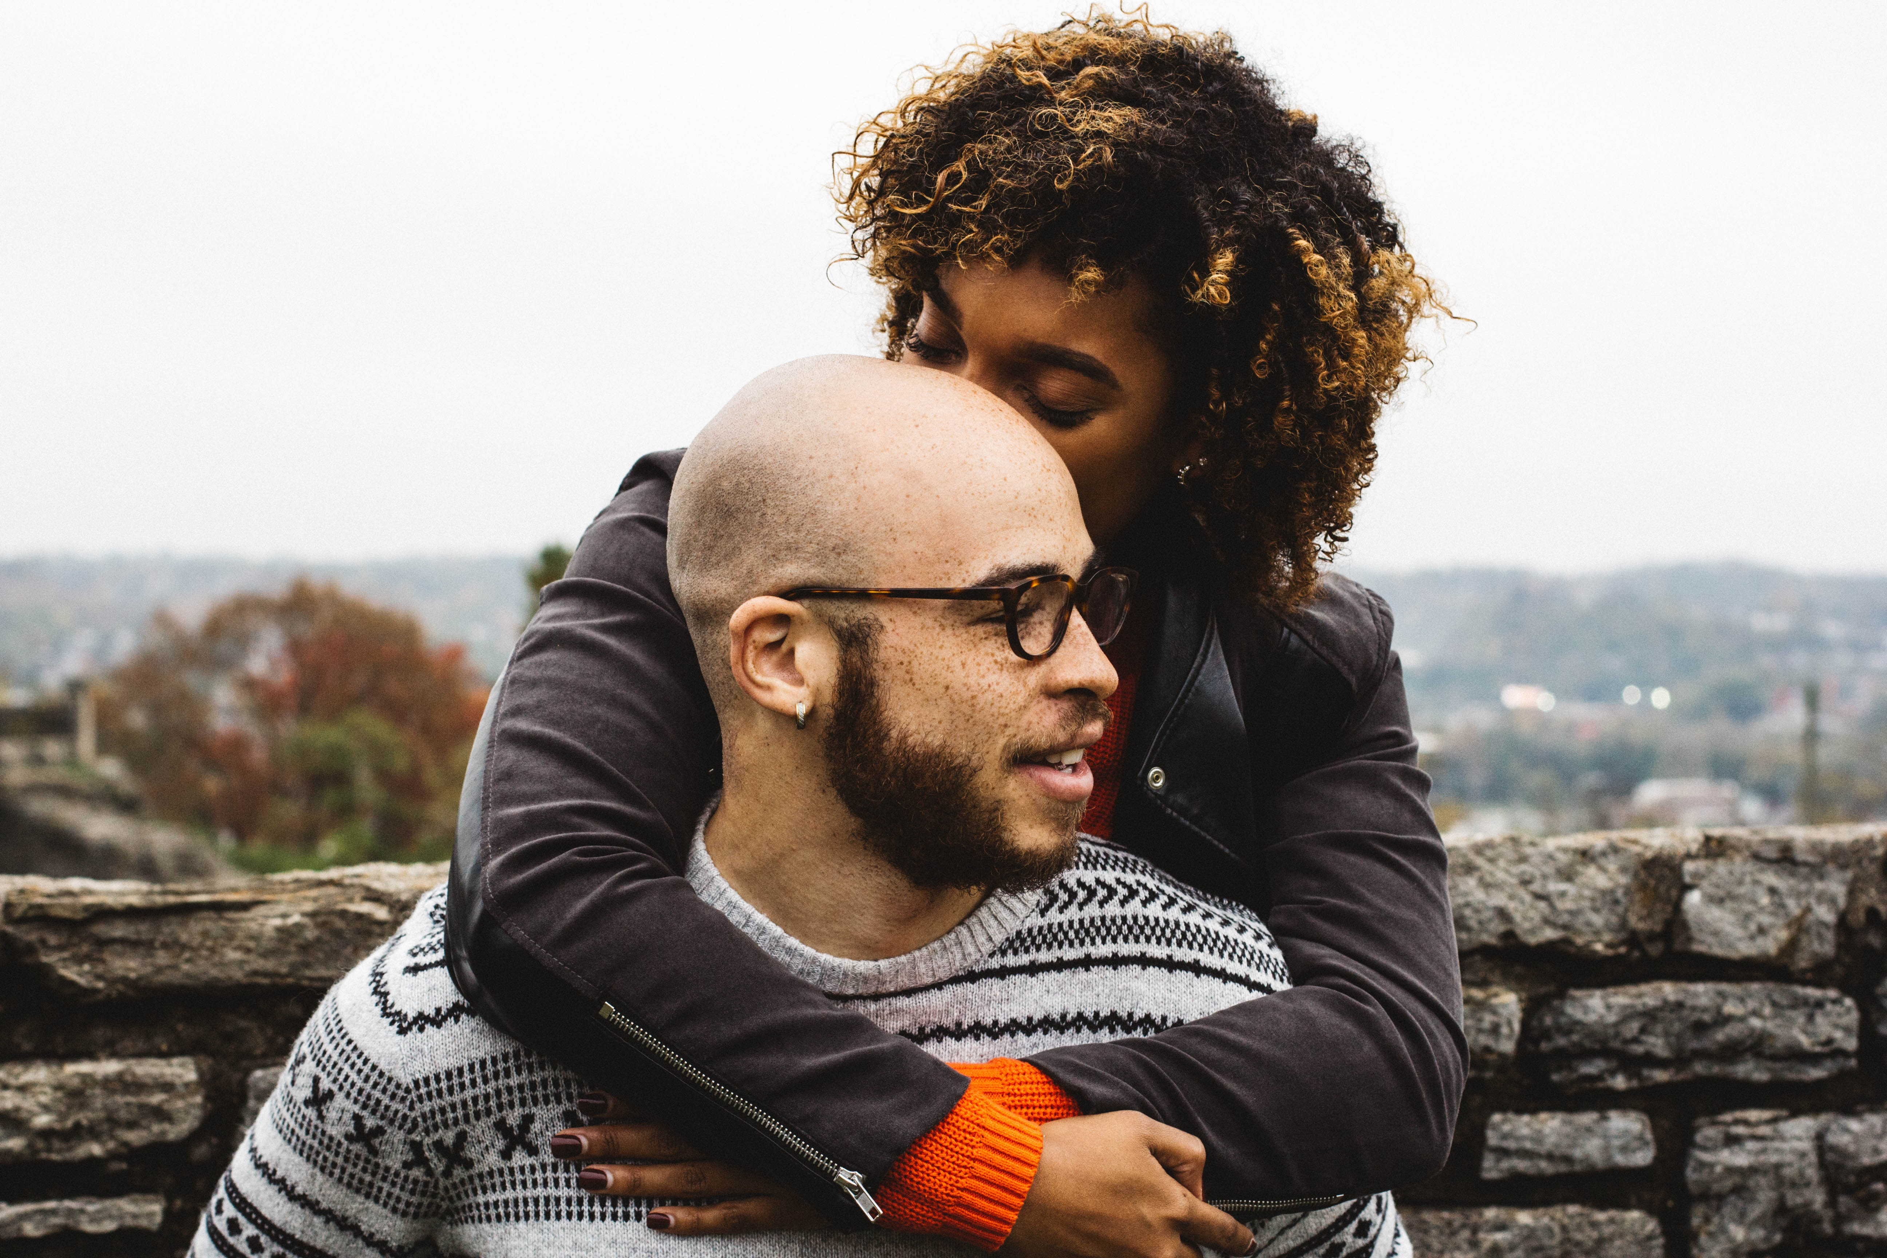
Ways to Help Your Relationship
Identify your attachment and create a coherent narrative.
Reveal destructive thought processes to each other.
Keep a journal. Out your inner coach.
Set goals for the relationship. Monitor your behavior.
Use the tools:
    Disarm.
Be generous.
Don’t board the train of destructive thoughts.

Slide 71

Webinars

Slide 72
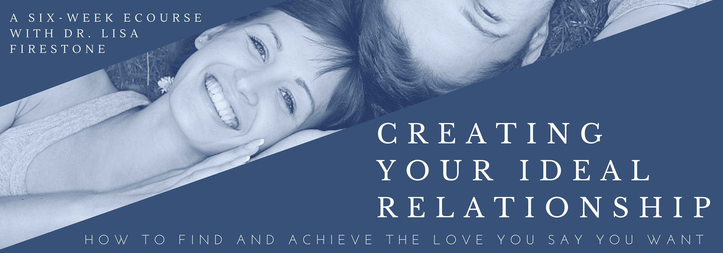
eCourses
Place your screenshot here
Sign Up Now
_______________________
_______________________

Slide 73
CE Information
CE’s for this Webinar are optional and sold separately through R. Cassidy Seminars. A link to purchase 1.5 CE’s will be e-mailed to registrants following the live Webinar. For those purchasing or watching this Webinar as an archived recording, a link to purchase home study CE’s was provided with your purchase confirmation. Registrants can earn 2 home study CE’s by watching the Webinar and completing a reading assignment.

Slide 74
Thank you!
Any questions?
Lisa Firestone, Ph.D.
lfirestone@glendon.org
Contact:
Glendon@Glendon.org
800-663-5281

