Slide 1

The Origins of Violence in Child Abuse
With Dr. James Garbarino

Slide 2
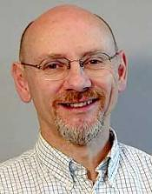
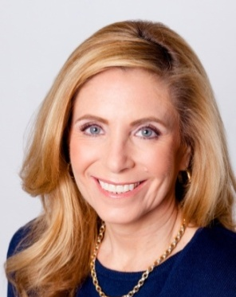


James Garbarino, Ph.D.
Author
Listening to Killers
Professor
Loyola University Chicago
Lisa Firestone, Ph.D.
Director of Research and Education The Glendon Association
Senior Editor PsychAlive.org
THE GLENDON
ASSOCIATION
(For Professionals) www.glendon.org
(For the Public) www.psychalive.org

Slide 3

Listening to Killers
This presentation is based upon James Garbarino’s 20 years as a psychological expert witness in murder cases, as presented in his 2015 book Listening to Killers.

Slide 4
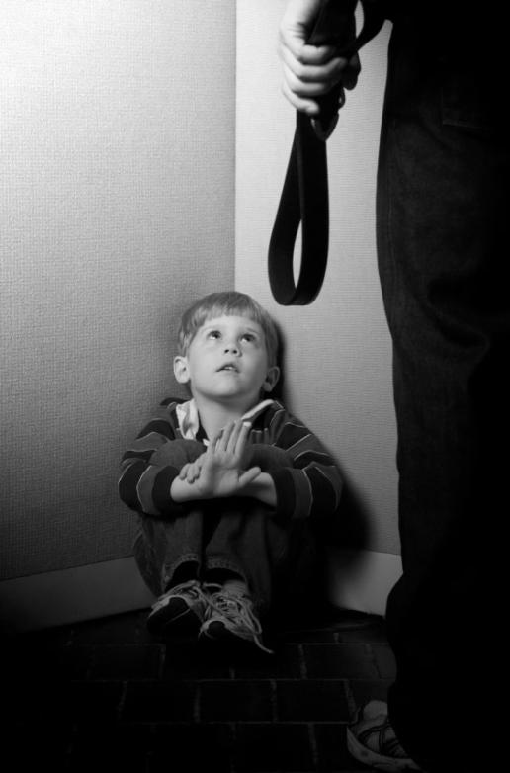
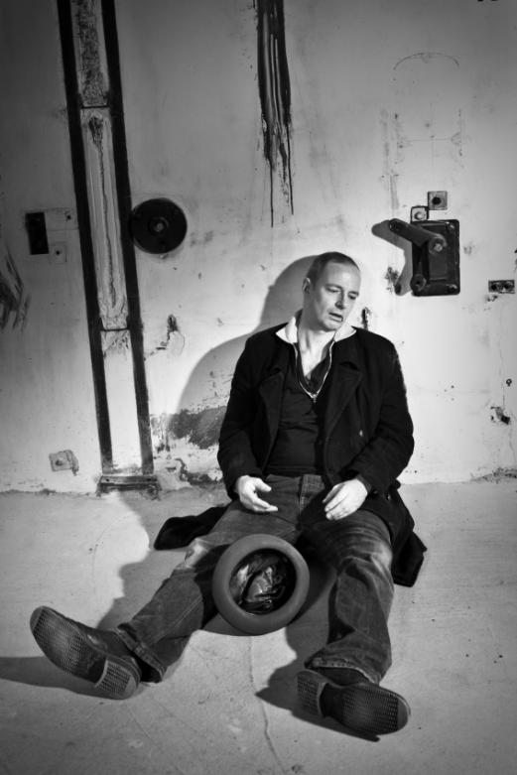
Working Hypothesis
The key to understanding violent men is that they are “untreated traumatized and abused children who inhabit and control the bodies of scary men.”

Slide 5

Conceptual Framework
A conceptual framework is needed that bridges the gap between:
“Social history" typically provided by social work
“Diagnosis" provided by clinical psychology

Slide 6

Developmental Analysis
Beyond these two approaches is a "developmental analysis" that seeks to explain what accounts for how violent men travel a path that leads from childhood innocence to violence in adolescence or adulthood.

Slide 7

Ecological Perspective
At the heart of these approaches is an “ecological perspective” that emphasizes the role of context in development:
If the question is, “Does X cause Y? The answer is ‘It depends.’”

Slide 8
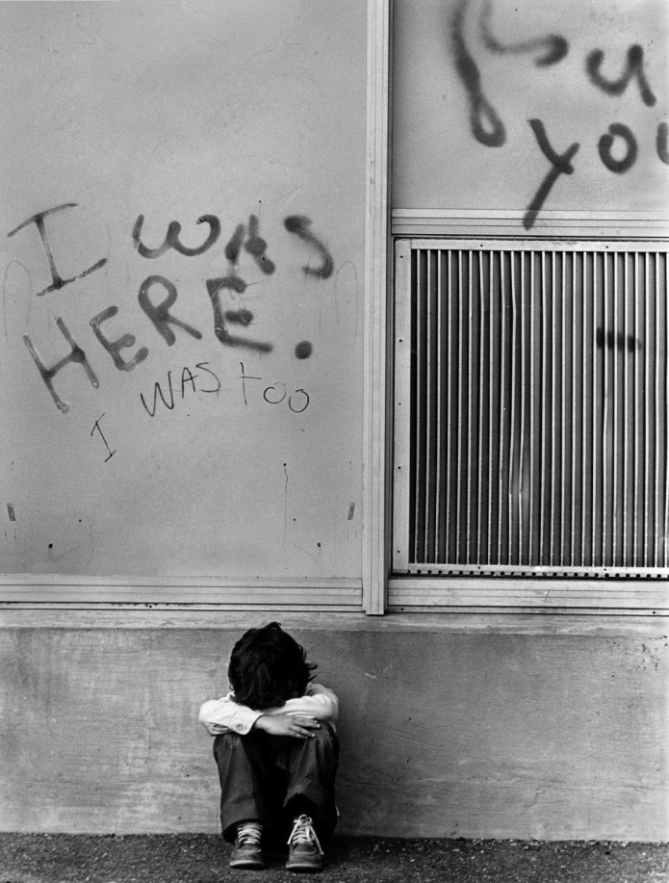
Three Types of Trauma
There are three types of trauma in childhood and adolescence that lead to damage.
Single acute incidents
Multiple occurrences
Pervasive severe victimization in early childhood

Slide 9

Moral Damage
Moral damage: “The War Zone Mentality”

Slide 10

Emotional Damage
Emotional damage: Emotional regulation

Slide 11

Key Issues
Key issues include:
Accumulation of risk factors and developmental assets
Attachment
Parental rejection
Genetic vulnerability
Social toxicity

Slide 12
Listening to Killers
http://www.ucpress.edu/

Slide 13

eCourses
Become Your True Self:
A Therapeutic Model for Differentiation
Overcome Your Inner Critic:
How to Free Yourself from Imagined Limitations
Visit ecourse.psychalive.org for a full list of eCourses.

Slide 14

Webinars
Visit www.psychalive.org for a full list of upcoming and archived free and CE Webinars

Slide 15
To receive your CE’s for this Webinar:
Upon completion of this Webinar, you will receive an email with all CE materials, including an accompanying article, an evaluation form and post test for you to complete online. Instructions will be given in the email.
A recording of this Webinar will also be emailed to you. Those unable to attend this live Webinar may view the recording and complete the CE forms to receive 3 CE Units for $35. A link to this recording will be sent to you as soon as it’s available.

Slide 16

Contact:
glendon@glendon.org
800-663-5281
THE GLENDON
ASSOCIATION
(For Professionals) www.glendon.org
(For the Public) www.psychalive.org

