Slide 1
Treating Violent Individuals: Developmental Issues, Assessing Risk & Effective Treatment Planning
Lisa Firestone, Ph.D.

Slide 2

Voices of Violence 1.10, clip 40

Slide 3


Our Approach to Violence
Each person is divided:
One part wants to live and is goal directed and life affirming.
And one part is self-critical and suspicious of others, self-hating and paranoid toward others, and at its ultimate end, destructive toward self and others. The nature and degree of this division varies for each individual.
Real Self - Positive
Anti-Self - Destruction

Slide 4
Our Approach to Violence
Destructive thoughts toward self and others contribute to violent behavior.
The are going to make a fool of you
You have to take care of yourself
Sometimes it feels so good
to explode
You deserve better then this
You can’t trust anyone

Slide 5


Our Approach to Violence
There is a direct relationship between how a person is thinking and how they are likely to behave.
Thoughts
Feelings
Event
Behavior

Slide 6
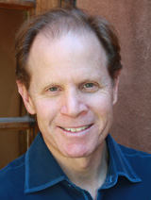
The Brain in the Palm of Your Hand
Daniel Siegel, M.D. – Interpersonal Neurobiology

Slide 7
The Low Road: An Example of Dis-Integration
Temporarily Disengaging the Prefrontal Cortex
Dissolves the nine functions of the PFC

Slide 8
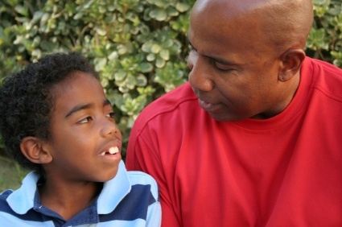









9 Important Functions of the
Pre-Frontal Cortex
Body Regulation
Attunement
Emotional Balance
Response Flexibility
Empathy
Self-Knowing Awareness (Insight)
Fear Modulation
Intuition
Morality

Slide 9
Emotional Regulation
“Experiences in infancy which result in the child’s inability to regulate strong emotions are too often the overlooked source of violence in children and adults.”
(Brazelton, 1997)

Slide 10

Abuse and Neglect
Expose the immature infant to threatening experiences
Deprive the developing brain/mind/body of interpersonal experiences necessary for developing a conscience

Slide 11
Neuro-cognitive Basis of
2 Types of Aggression
Hostile/Reactive
  Individual perceives a threat, reacts violently
  Acquired sociopathy
  Legions in the orbital frontal cortex
Instrumental/Proactive
  Individual sees violence as a means to obtain a desired goal
  Developmental psychopathy
  Amygdala malfunctions

Slide 12

Developmental 5.35, clip 95

Slide 13
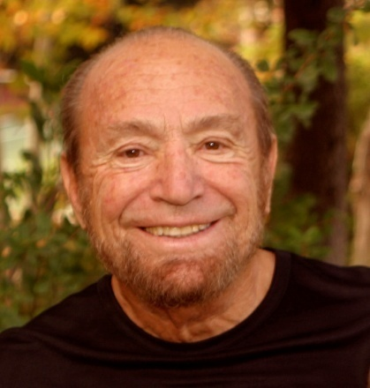
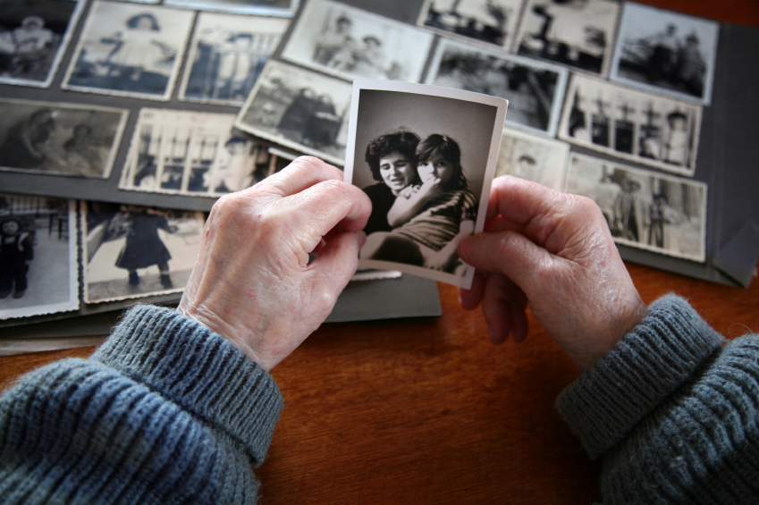
Separation Theory
Robert W. Firestone, Ph.D.
Integrates psychoanalytic and existential systems of thought
Two kinds of emotional pain:
  Interpersonal
  Existential
The core conflict
Defended versus undefended lifestyles
The concept of the Fantasy Bond
The concept of the Critical Inner Voice

Slide 14

Division of the Mind 2.08, clip 209

Slide 15


Division of the Mind
Parental Ambivalence
Parents both love and hate themselves and extend both reactions to their productions, i.e., their children.
Parental Nurturance
Parental Rejection, Neglect Hostility
Notes:
15

Slide 16




Prenatal Influences
Disease Trauma
Substance Abuse/ Domestic Violence
Notes:
16

Slide 17


Birth
Trauma
Baby
Genetic
Structure
Temperament
Physicality
Sex
Notes:
17

Slide 18

Self-System
Parental Nurturance
Unique make-up of the individual
(genetic predisposition and temperament); harmonious identification and incorporation of parent’s positive attitudes and traits and parents positive behaviors: attunement, affection,
control, nurturance; and the effect of other nurturing experience and
education on the maturing self-system resulting in a sense of self and a greater degree of differentiation from parents
and early caretakers.

Slide 19



Personal Attitudes/
Goals/Conscience
Realistic, Positive Attitudes Toward Self
Realistic evaluation of talents, abilities, etc…with generally positive/ compassionate attitude towards self and others.
Behavior
Ethical behavior
towards self and others
Goal Directed Behavior
Goals
Needs, wants, search for meaning in life
Moral Principles
Acting with
Integrity

Slide 20

Anti-Self System
Unique vulnerability: genetic predisposition and temperament
Destructive parental behavior: misattunement, lack of affection, rejection, neglect, hostility, over permissiveness
Other Factors: accidents, illnesses, traumatic separation, death anxiety
The Fantasy Bond (core defense) is a self-parenting process made up of two elements: the helpless, needy child, and the self-punishing, self-nurturing parent. Either aspect may be extended to relationships. The degree of defense is proportional to the amount of damage sustained while growing up.

Slide 21



Anti-Self System
Self-Punishing Voice Process
Voice Process
1. Critical thoughts toward self
2. Micro-suicidal injunctions
3. Suicidal injunctions –
suicidal ideation
Behaviors
Verbal self-attacks – a generally negative attitude toward self and others predisposing alienation.
Addictive patterns. Self-punitive thoughts after indulging.
Actions that jeopardize, such as carelessness with one’s body, physical attacks on the self, and actual suicide
Source
Critical parental attitudes, projections, and unreasonable expectations.
Identification with parents defenses
Parents’ covert and overt aggression (identification with the aggressor).
Notes:
21

Slide 22



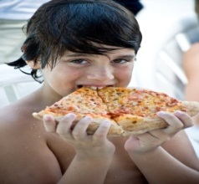

Anti–Self System
Self- Soothing Voice Process
Voice Process
1. Self-soothing
attitudes
2. Aggrandizing
thoughts toward self
3. Suspicious paranoid
thoughts toward
others.
4. Micro-suicidal
injunctions
5. Overtly violent
thoughts
Behaviors
Self-limiting or self-protective lifestyles, Inwardness
Verbal build up toward self
Alienation from others, destructive behavior towards others.
Addictive patterns. Thoughts luring the person into indulging.
Aggressive actions, actual violence.
Source
Parental over protection, imitation of parents’ defenses
Parental build up
Parental attitudes, child abuse, experienced victimization.
Imitation of parents’ defenses.
Parental neglect, parents’ overt aggression (identification with the aggressor).
Notes:
22

Slide 23

Fonagy clip 2.49, clip 96

Slide 24
Why Use Objective Measures?
What Interferes with Clinical Judgment
Anxiety
Counter Transference
Paranoid
Research Minimizing
Diverse Menu of Risk Factors

Slide 25
Problems with Clinical Judgment
Example:
Huss and Zeiss (2004) found that individual clinicians are unable to predict violence through clinical methods. Webster, Hucker, and Bloom (2002) also found that clinicians lack consensus for indentifying the presence of risk factors using the same vignette about a violent individual.
Professionals are frequently consulted to diagnose and predict human behavior; optimal treatment and planning often hinge on the consultant’s judgmental accuracy. Research comparing these two approaches shows the actuarial method to be superior. Dawes, Faust, Meehl (1989)
On average, mechanical-prediction techniques were about 10% more accurate than clinical prediction. Grove, Zald, Lebow, Snitz, Nelson (2000)

Slide 26
Problems with Static Risk Factors Adolescent Murderers
Less likely to be arrested previous
Less likely to be placed in juvenile facilities prior
Less likely to have a history of prior mental health treatment

Slide 27
Static and Dynamic Risk Factors
Static risk factors: factors that do not change over time or setting, i.e., age of first offense and demographic variables.
Dynamic Risk Factors: factors that change over time and setting, i.e., present clinical status and substance use.

Slide 28
Thoughts to Actions Quote
A. Beck and Pretzer (2005) stated the hypothesis of thoughts influence on behavior in this way:
Our seminal insight was the observation that the content of individuals’ thoughts influences their emotional and behavioral response…. Thoughts of being wronged or mistreated produce anger and an impulse to retaliate. (p. 68) …When the adversary is demonized (viewed as different, alien, subhuman, and evil), this intensifies the sense that violence is justified and reduces inhibitions about violence and killing. (p. 72) …The greater the extent to which additional cognitions legitimize a violent response, the greater the likelihood of violence. (p. 71)

Slide 29

Scales, 8.47, Clip 211

Slide 30
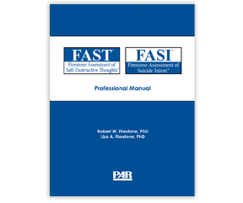
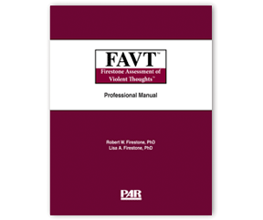
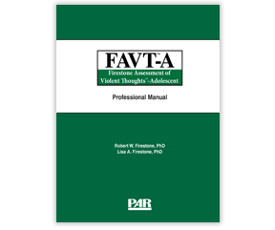
Our Measures
Based on Separation Theory developed by Robert W. Firestone, PhD. and represents a broadly based coherent system of concepts and hypothesis that integrates psychoanalytic and existential systems of thought. The theoretical approach focuses on internal negative thought processes. These thoughts (i.e. “voices”) actually direct behavior and, thus, are likely to predict how an individual will behave.

Slide 31
FAVT: Adult Version ©
Instructions
All people experience thoughts or inner voices that are critical and sometimes destructive towards themselves
and others. For example when a person feels angry or hurt, he (she) might think to himself (herself): “You’ve
got to get even, Let them have it.” When a person is worried about his (her) job, he (she) might say to himself
(herself): “They don’t see that you are working hard, they’re just taking advantage of you.”
Negative thoughts or inner voices are a part of everyone's day to day thinking. The following is a list of
thoughts ⎯ voices that people may experience. Please read through each one and indicate, by circling the
number that matches how frequently you experience this thought or voice.
Example:
Rarely Frequently
Almost Never Sometimes Almost Always
You've got to get even, let them have it. 1 2 3
 |  | Rarely Almost Never | Sometimes | Frequently Almost Always
1. | Nobody understands you. | 1 | 2 | 3
2. | You idiot! You were faithful to him (her). Now look at what he’s (she’s) done and everybody knows. | 1 | 2 | 3
3. | How can he (she) talk to you like that. | 1 | 2 | 3

Slide 32

Firestone Assessment of
Violent Thoughts (FAVT)
Level 1: Paranoid/ Suspicious
“They are out to get you”
You can never trust a woman (man).
You can’t trust anyone.
Keep those immigrants out. They don’t deserve anything.

Slide 33

Firestone Assessment of
Violent Thoughts (FAVT)
Level 2: Persecuted Misfit
“They are going to make a fool of you”
How can they talk to you like that?
Nobody sees how much you contribute.
No one appreciates you. So just forget them!
They’re just doing this to make you get upset.

Slide 34

Firestone Assessment of
Violent Thoughts (FAVT)
Level 3: Self-Depreciating/Pseudo-Independent
“You have to take care of yourself”
Nobody understands you.
You idiot! You were faithful to him (her).
Now look at what he’s (she’s) done
and everybody knows.
They shouldn’t have done that to you. They knew better.

Slide 35

Firestone Assessment of
Violent Thoughts (FAVT)
Level 4: Overtly Aggressive
“Violence is the ticket”
Look at all these people here that you could hurt and blow away.
You’re somebody if you have a gun. You have control. You get respect.
Sometime it feels so good just to explode.

Slide 36

Firestone Assessment of
Violent Thoughts (FAVT)
Level 5: Self-Aggrandizing
“You are #1”
You deserve better than this!
You can do anything you set your mind to.
You’re strong. You don’t really need them in your life.

Slide 37
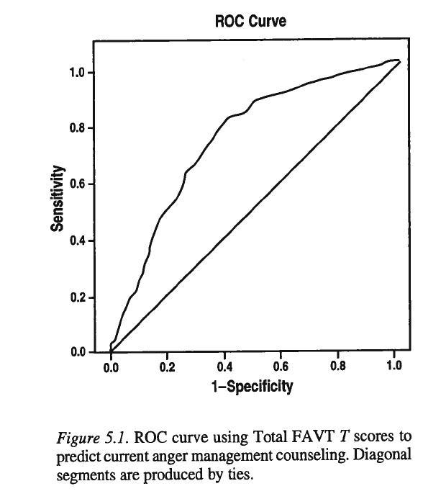

Slide 38
Assessment for the presence of actuarial risk factors and other collateral information
VRAG
Past records: criminal, psychiatric, and legal
Collateral interviews with significant others
None-to-low risk
Continue risk monitoring
Proceed with appropriate interventions or actions consistent with the person’s need
Mild risk
Administer
FAVT
Conduct clinical interview
Establish rapport
Ask direct questions about violent ideation and behavior
Investigate perception of current situation and how it relates to past trauma
Investigate attachment history
Investigate trauma history
Evaluate emotional regulation skills
Evaluate the propensity to disassociate
Quality of peer relationships
Pay attention to clinical, impression, dislike, malice, aversion, discomfort
Document rationale
Moderate risk
Assess imminence
Immediate danger
High risk
No immediate danger
See Figure 3.2 and 3.3
Assess for new information relevant to violence risk (e.g., reports by others) and pay attention to changes that might trigger violence risk
Document rationale and evidence for conclusions
Continue monitoring risk
Proceed with appropriate interventions or actions consistent with the person’s needs
Physiological measures (e.g., heart rate, skin reactivity, brain scans)
Figure 3.1. Flowchart: Assessment and management of potentially violent individuals (VRAG = Violence Risk Appraisal Guide [ Harris, Rice, & Quinsey, 1993])

Slide 39
Danger of imminent risk
No
Document rationale for decision
Restrict means for violence (i.e., remove guns or other weapons)
Referral for psychiatric evaluation
Yes
Continue appropriate treatment
Evaluate necessity for inpatient treatment
Determine necessity of warning potential targets
No
Increased contact
Is voluntary hospitalization an option or advisable?
Document rationale for decision
Yes
When possible, involve responsible others
Yes
No
Warn potential targets and foreseeable collateral victims
Ensure availability
Initiate voluntary hospitalization
Initiate involuntary hospitalization
Seek consultation
Contact appropriate law enforcement agency
Prepare in advance for crisis
Maintain contact
Document actions taken and rationale for decisions; follow up carefully
Reassess risk regularly, particularly around the time of release
Reassess risk
Warn potential targets and foreseeable collateral victims if still relevant upon release
Be aware of triggers and behavioral changes indicating increased risk
Continue providing appropriate intervention
Warn appropriate law enforcement agencies if still appropriate upon release
Restrict access to means
Figure 3.2 Flowchart: Assessment and management of potentially violent individuals in nonrestrictive setting

Slide 40
Danger of imminent risk
No
Consider least restrictive option
Document rationale and evidence for decisions; follow up carefully
Yes
Be aware of triggers and behavioral changes indicating increased risk
Consider most restrictive option available
Continue appropriate level of intervention
Document rationale and evidence for decisions made
Continue monitoring risk
Remove access to foreseeable targets
Assess for new information relevant to violence risk (e.g., reports by others) and pay attention to changes that might trigger violence risk
Be aware of triggers and minimize exposure to triggers
Obtain a psychiatric evaluation
Provide appropriate level of intervention
Continue monitoring risk
Figure 3.3 Flowchart: Assessment and management of potentially violent individuals in restrictive settings.

Slide 41
Conduct interviews with the potential attacker and collaterals from different systems
Information to focus on:
Planning ideation
Past coping behavior under unbearable stress
  Is there a trusting relationship with a significant other?
  Is the person stable emotionally?
Nature of past traumas
Hopelessness/ depression/ despair
Reactions of significant others (what do they communicate regarding violence?)
Nature of grievance with the target and how this relates to past trauma
Perceived behavior of the target
Past triggers for violence
Nature of the current crisis
Motivation for violence’
Fascination with violence or violent individuals
Attitude of violence acceptable
Others concerned about attacker’s violence potential
Discern the behavior of the potential attacker, close others, and the target
Information to focus on:
Evidence of planning behavior (e.g., notes) and preemptory behavior (e.g., acquiring weapons)
Evidence of past behaviors under stress, records, and violence history. Is there someone whom he or she trusted and whom he or she tried to harm in the past?
Evidence of past traumas
Behavioral evidence of emotions of hopelessness or despair
Evidence of significant others endorsing or ignoring violent behavior
Evidence regarding the grievance; the behavior of the potential attacker
Evidence of target’s behavior; provocation or safety measures taken
Evidence of past triggers for violence
Behavioral reaction to the current crisis
Evidence of motivation in writing or behavior. Is there a goal?
Evidence of behavior (e.g., collecting violent person’s writings or news coverage of violence)
Behaviors which evidence that violence is acceptable or desirable
Actions taken by others to address violence potential
Administer the FAVT
Continue to Figure 3.1
Figure 3.4 Targeted violence model for threat assessment (instrumental).

Slide 42
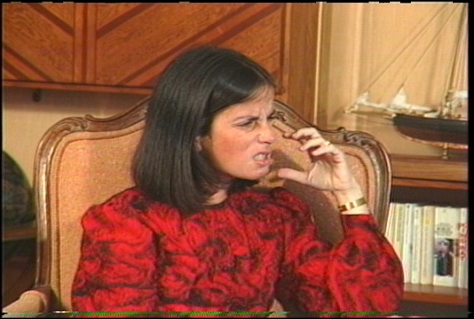
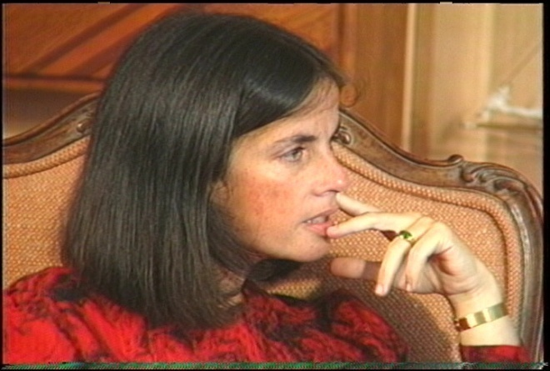
The Therapeutic Process in Voice Therapy
Step I
Identify the content of the person’s negative thought process. The person is taught to articulate his or her self-attacks in the second person. The person is encouraged to say the attack as he or she hears it or experiences it. If the person is holding back feelings, he or she is encouraged to express them.
Step II
The person discusses insights and reactions to verbalizing the voice. The person attempts to understand the relationship between voice attacks and early life experience.

Slide 43
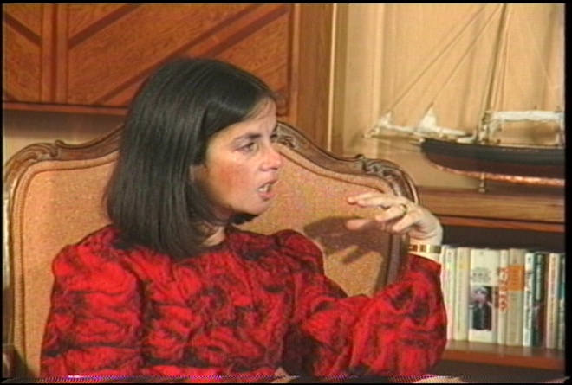
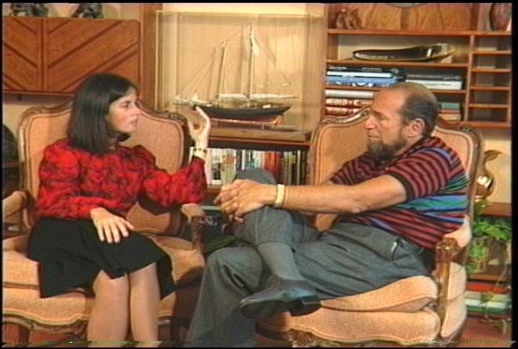
The Therapeutic Process
in Voice Therapy
Step III
The person answers back to the voice attacks, which is often a cathartic experience. Afterwards, it is important for the person to make a rational statement about how he or she really is, how other people really are, what is true about his or her social world.
Step IV
The person develops insight about how the voice attacks are influencing his or her present-day behaviors.
Step V
The person then collaborates with the therapist to plan changes in these behaviors. The person is encouraged to not engage in self-destructive behavior dictated by his or her negative thoughts and to also increase the positive behaviors these negative thoughts discourage.

Slide 44

Voice Therapy 4.33, clip 97

Slide 45
Resolve to Stop the Violence Project (RSVP)
Population
  62 bed open dormitory unit
  Violent offenders
Goals
  Change the culture of the male role belief system
  Change the violence-prone character structure
  Change violence-precipitating cognitions, emotions, and actions

Slide 46
RSVP-Treatment
Intensive treatment 12 hours/day, 6 days/week
  Group discussion, academic classes, theatrical enactments and role-play, counseling sessions, presentations and discussions with victims of crime
Man Alive Groups
  Cognitively-oriented small group meetings
  2 ½ hour groups, 3 times a day
  Each session focuses on one man
  Participants discuss their two identities: the “real self” and the “hit man”

Slide 47

Implementing Skills 1.11, clip 213

Slide 48
Grendon Prison, Oxford
Population
  Category B High Security Prison
  All violent offenders
  50% have life sentence for murder
  25% Psychopathic
  5 units, 40 men each

Slide 49
Grendon Approach to Treatment
Psychodynamic small group therapy every other morning
Inmates play an active role
Dynamic understanding of their crime
Drama and Art therapy
Twice a week unit meetings

Slide 50
Theory and Technique
Traumatized patients – adults as well as children – develop negative introjects.
Sufferers “resist” therapy by using predictable strategies to avoid their unconscious painful feelings.
These true feelings are those of traumatized love
  Pain/Shame (of Trauma)
  Grief (Longing)
  Anger (Person, Situation)
  Guilt ( Strongest for those whose anger is at caregiver)

Slide 51
Repairing the Attachment System
The therapist is then perceived as a new attachment figure
The therapist’s mind wants to explore and understand and co-contain the patient’s feelings
Successful mastery of resistance causes internalization of the therapist as a secure figure
A new working model of attachment is created (F5)

Slide 52
Ways to Change a Brain
Mechanisms of Change:
  Synaptogenesis
  Neurogenesis
  Myelinogenesis
  Epigenesis
Strategies of Change:
  The Focus of Attention activates specific circuits
  A Sense of Trust enhances receptive learning
  Memory Retrieval as a Memory Modifier
  Unlearning and Learning
  Deep Practice and Skill Training

Slide 53
Brain Development: Inspire to Rewire
Repeated Activation Creates, Strengthens and Maintains Connections:
  “Neurons which FIRE together WIRE together”
Development across the lifespan: plasticity, neural pathways and self-organization: Life-Long Learning!
A simple idea: “Human connections shape neural connections”

Slide 54




Interpersonal Neurobiology
C urious
O pen
A ccepting
L oving

Slide 55
Integration, Psychotherapy and Neuroplasticity
“Effective Therapy Changes the Brain” can be restated as “Effective Therapy Integrates the Brain”
Integration creates Harmony
Regions are Differentiated and then Linked
Impairments to Integration lead to Chaos and/or rigidity
The Nine Domains of Integration
Strategies for Enhancing Neuroplasticity

Slide 56
Nine Domains of Integration
Consciousness
Bilateral
Vertical
Memory
Narrative
State
Interpersonal
Temporal
Transpirational

Slide 57
Assessment Instruments
FAVT and FAVT-A

Slide 58

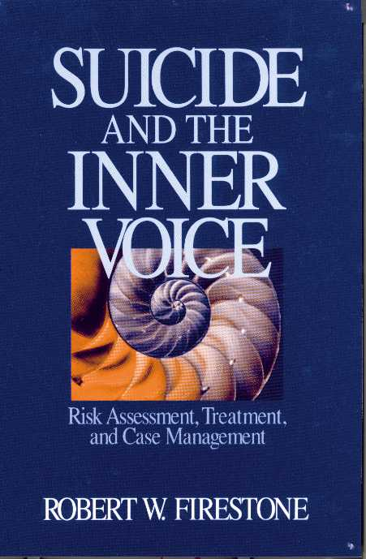


Resources: Books
Visit www.psychalive.org for resource links

Slide 59




Resources: Films
Visit www.psychalive.org for resource links

Slide 60


Upcoming Webinars from PsychAlive.org
 | Apr. 18 FREE Mindfulness in Everyday Life: The Way to Happiness and Meaning Free Webinar Presenter: Dr. Donna Rockwell 11am – 12pm PST
 | May 7 Social Media and Marketing for Psychologists, Non-Profits and Mental Health Professionals FREE Webinar Presenter: Dr. Lisa Firestone and Lena 11am – 12pm PST
See a Full List of Upcoming Free and CE Webinars with
Dr. Lisa Firestone and other Expert Presenters at:
Learn more or register at http://www.psychalive.org/2012/01/upcoming-webinars-2/

Slide 61
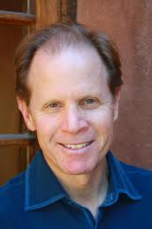
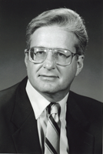
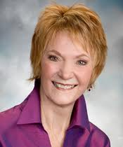
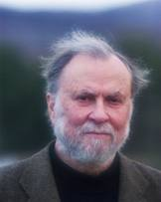
Archived CE Webinars
Watch CE Webinars online at your convenience featuring expert presenters that include:
Dr. Daniel Siegel
Dr. Donald Meichenbaum
Dr. James Gilligan
Dr. Pat Love
Dr. Lisa Firestone
Dr. Sheldon Solomon
Dr. Christine Courtois
…and more…
See the full list at
http://www.glendon.org/resource-category/archived-webinars/

Slide 62



Contact:
Glendon@glendon.org
Toll Free - 800-663-5281
(For Professionals) www.glendon.org
(For the Public) www.psychalive.org

Slide 63
Contact Information
Dr. Lisa Firestone
Phone (805) 681-0415
Email: lfirestone@glendon.org
Website: www.glendon.org
Facebook: Glendon Association
Link to Handout: http://www.psychalive.org/2013/04/treating-violent-individuals-nofsw-conference/

