Slide 1

Ambivalence in Suicide
Lisa Firestone, Ph.D.
The Glendon Association
American Association of Suicidology 2013

Slide 2




Our Approach to Suicide
Each person is divided:
One part wants to live and is goal directed and life affirming.
And one part is self-critical, self-hating and at its ultimate end, self-destructive. The nature and degree of this division varies for each individual.
Real Self - Positive
Anti-Self - Critical

Slide 3
Our Approach to Suicide
Negative thoughts exist on a continuum, from mild self-critical thoughts to extreme self-hatred to thoughts about suicide
You need to have a drink, so you can relax
You don’t deserve anything
You should be by yourself
You should just kill yourself
You’re a creep

Slide 4
Our Approach to Suicide
Self-destructive behaviors exist on a continuum from self-denial to substance abuse to actual suicide.
Hating Yourself
Substance Abuse
Self-Denial
Isolation
Risk Taking
Suicide

Slide 5


Our Approach to Suicide
There is a relationship between these two continuums. How a person is thinking is predictive of how he or she is likely to behave.
Thoughts
Feelings
Event
Behavior

Slide 6

Ambivalence in Suicide, Clip 247, 7.39

Slide 7
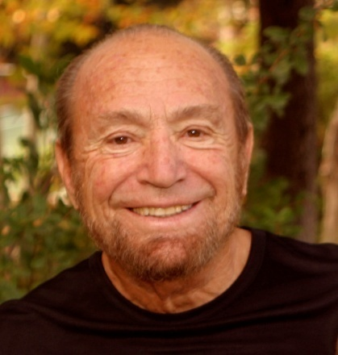
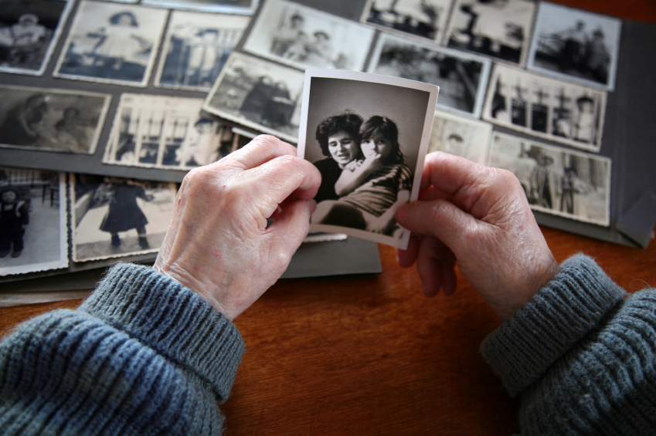
Separation Theory
Robert W. Firestone, Ph.D.
Integrates psychoanalytic and existential systems of thought
Two kinds of emotional pain:
  Interpersonal
  Existential
The core conflict
Defended versus undefended lifestyles
The concept of the Fantasy Bond
The concept of the Critical Inner Voice

Slide 8

Definition of the Voice
The critical inner voice refers to a well-integrated pattern of destructive thoughts toward our selves and others. The “voices” that make up this internalized dialogue are at the root of much of our maladaptive behavior. This internal enemy fosters inwardness, distrust, self-criticism, self-denial, addictions and a retreat from goal-directed activities. The critical inner voice effects every aspect of our lives: our self-esteem and confidence, our personal and intimate relationships, and our performance and accomplishments at school and work.

Slide 9


Division of the Mind
Parental Ambivalence
Parents both love and hate themselves and extend both reactions to their productions, i.e., their children.
Parental Nurturance
Parental Rejection, Neglect, Hostility
Notes:
9

Slide 10




Prenatal Influences
Disease Trauma
Substance Abuse/ Domestic Violence
Notes:
10

Slide 11


Birth
Trauma
Baby
Genetic
Structure
Temperament
Physicality
Sex
Notes:
11

Slide 12

Self-System
Unique make-up of the individual (genetic predisposition and temperament)
Harmonious identification and incorporation of parent’s positive attitudes and traits and parents positive behaviors (attunement, affection, control, nurturance)
The effect of other nurturing experience and education on the maturing self-system resulting in a sense of self and a greater degree of differentiation from parents and early caretakers.
Notes:
12

Slide 13



Personal Attitudes/Goals/Conscience
Realistic, Positive Attitudes Towards Self
Behavior
Realistic evaluation of talents, abilities, etc…with generally positive/ compassionate attitude towards self and others.
Ethical behavior
towards self and others
Goal Directed Behavior
Goals
Needs, wants, search for meaning in life
Moral Principles
Acting with Integrity

Slide 14

Anti-Self System
Unique vulnerability: genetic predisposition and temperament
Destructive parental behavior: misattunement, lack of affection, rejection, neglect, hostility, over permissiveness
Other Factors: accidents, illnesses, traumatic separation, death anxiety
The Fantasy Bond (core defense) is a self-parenting process made up of two elements: the helpless, needy child, and the self-punishing, self-nurturing parent. Either aspect may be extended to relationships. The degree of defense is proportional to the amount of damage sustained while growing up.
Learn more here
Notes:
14

Slide 15



Anti-Self System
Self-Punishing Voice Process
Voice Process
1. Critical thoughts toward self
2. Micro-suicidal injunctions
3. Suicidal injunctions -suicidal ideation
Behaviors
Verbal self-attacks - a generally negative attitude toward self and others predisposing alienation
Addictive patterns - self-punitive thoughts after indulging
Actions that jeopardize, such as carelessness with one’s body, physical attacks on the self, and actual suicide
Notes:
15

Slide 16





Anti–Self System
Self- Soothing Voice Process
Voice Process
1. Self-soothing attitudes
2. Aggrandizing
thoughts toward self
3. Suspicious paranoid
thoughts towards others
4. Micro-suicidal
Injunctions
5. Overtly Violent
thoughts
Behaviors
Self-limiting or self-protective lifestyles, Inwardness
Verbal build up toward self
Alienation from others, destructive behavior towards others
Addictive patterns. Thoughts luring the person into indulging
Aggressive actions, actual violence
Notes:
16

Slide 17
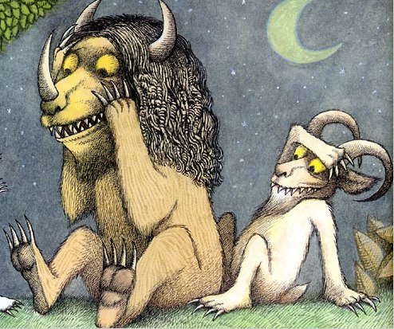
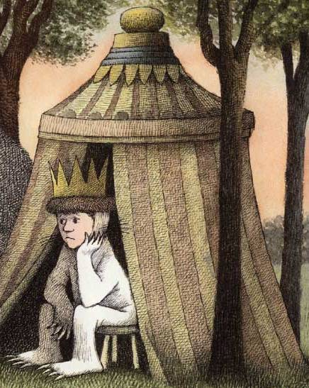
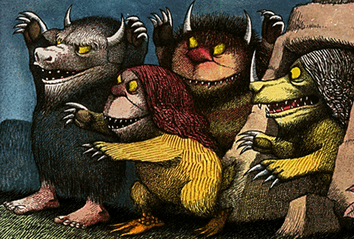
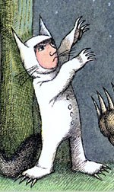
Self
Anti-Self

Slide 18
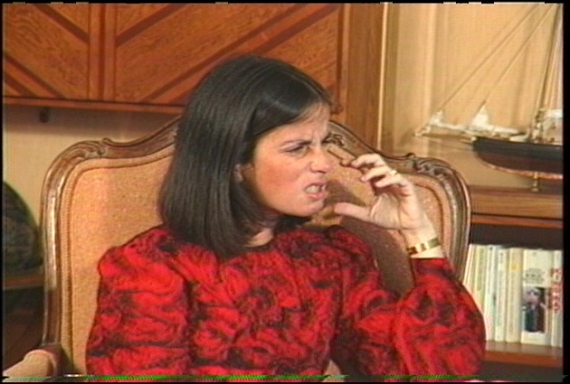
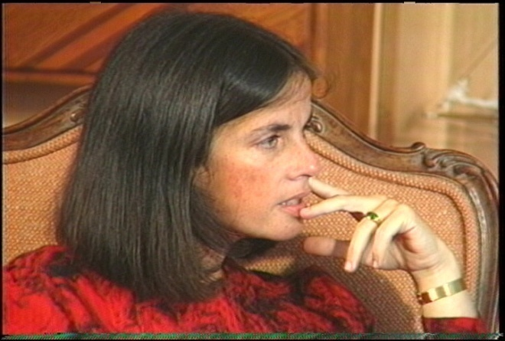
The Therapeutic Process in Voice Therapy
Step I
Identify the content of the person’s negative thought process. The person is taught to articulate his or her self-attacks in the second person. The person is encouraged to say the attack as he or she hears it or experiences it. If the person is holding back feelings, he or she is encouraged to express them.
Step II
The person discusses insights and reactions to verbalizing the voice. The person attempts to understand the relationship between voice attacks and early life experience.

Slide 19
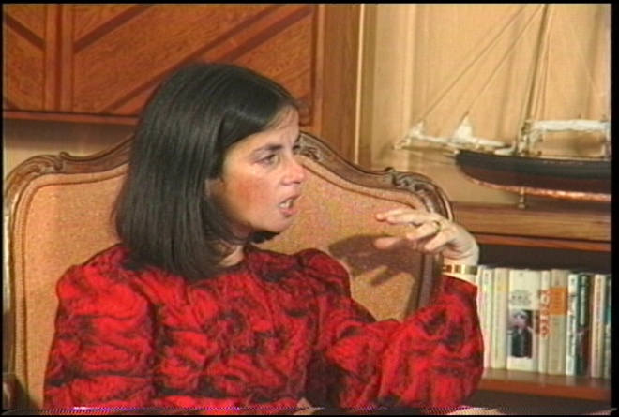
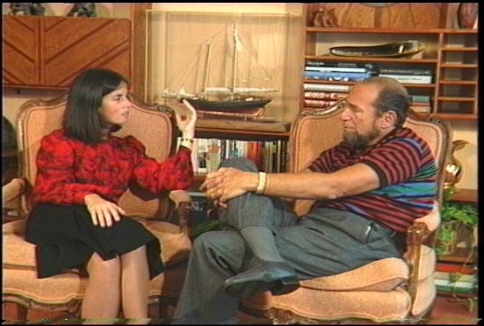
The Therapeutic Process
in Voice Therapy
Step III
The person answers back to the voice attacks, which is often a cathartic experience. Afterwards, it is important for the person to make a rational statement about how he or she really is, how other people really are, what is true about his or her social world.
Step IV
The person develops insight about how the voice attacks are influencing his or her present-day behaviors.
Step V
The person then collaborates with the therapist to plan changes in these behaviors. The person is encouraged to not engage in self-destructive behavior dictated by his or her negative thoughts and to also increase the positive behaviors these negative thoughts discourage.

Slide 20
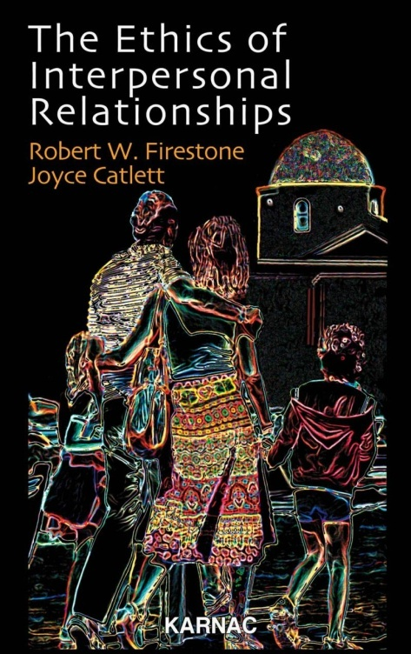
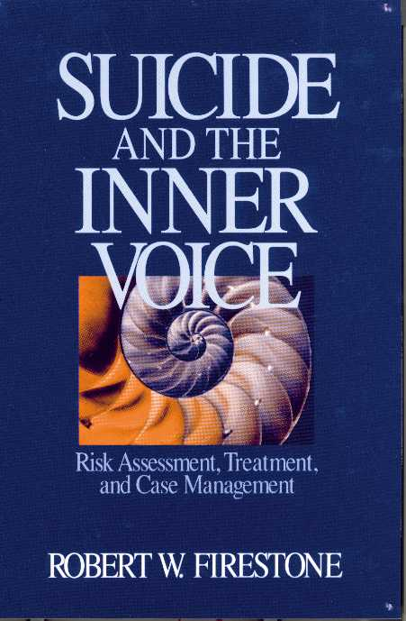

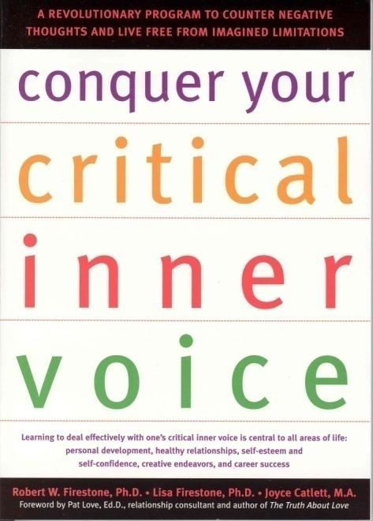
Resources: Books
Visit www.psychalive.org for resource links

Slide 21
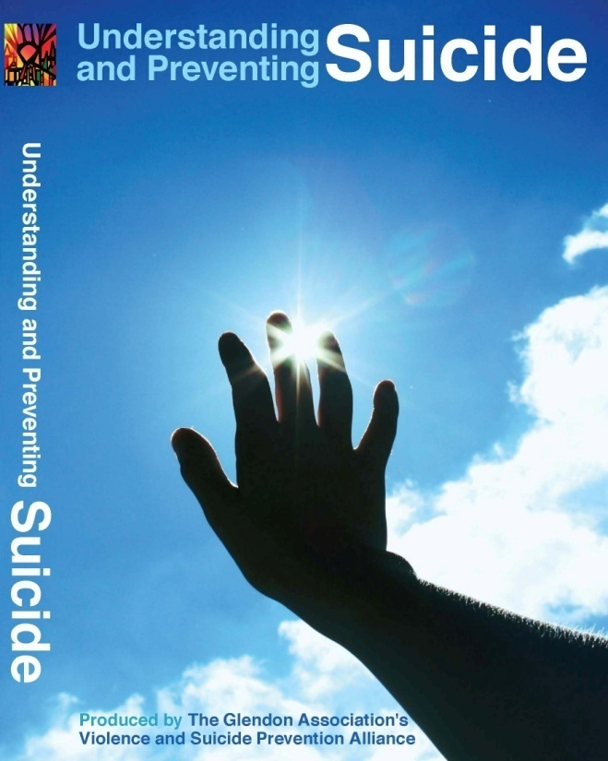

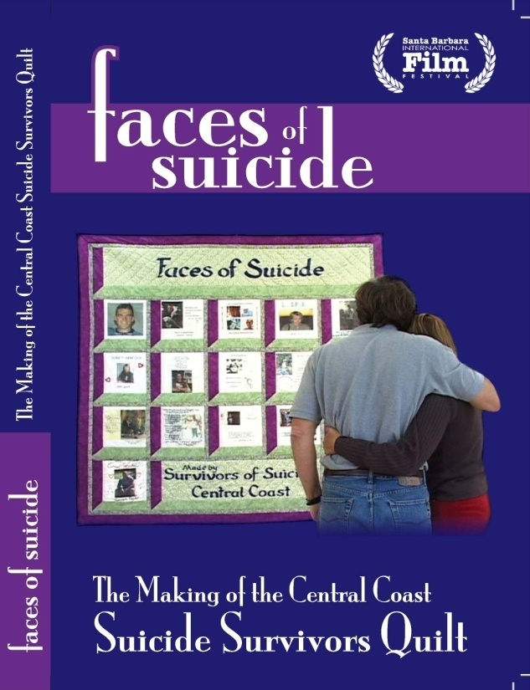
Resources: Films
For the Public
For Professionals
For Survivors
Visit www.psychalive.org for resource links

Slide 22


Upcoming Webinars from PsychAlive.org
 | May 7 Social Media and Marketing for Psychologists, Non-Profits and Mental Health Professionals FREE Webinar Presenter: Dr. Lisa Firestone and Lena Firestone 11am – 12pm PST
 | May 21 The Self Under Siege: A New Model of Differentiation CE Webinar Presenter: Dr. Lisa Firestone 4pm – 5:30pm PST $35, 3 CE’s
See a Full List of Upcoming Free and CE Webinars with
Dr. Lisa Firestone and other Expert Presenters at:
Learn more or register at http://www.psychalive.org/2012/01/upcoming-webinars-2/

Slide 23



Contact:
Glendon@glendon.org
Toll Free - 800-663-5281
(For Professionals) www.glendon.org
(For the Public) www.psychalive.org

Slide 24

Contact Information
Dr. Lisa Firestone
Phone (805) 681-0415
Email: lfirestone@glendon.org
Website: www.glendon.org
Facebook: Glendon Association

